Slide 1
Heroes

Slide 2
Destroyers

Slide 3

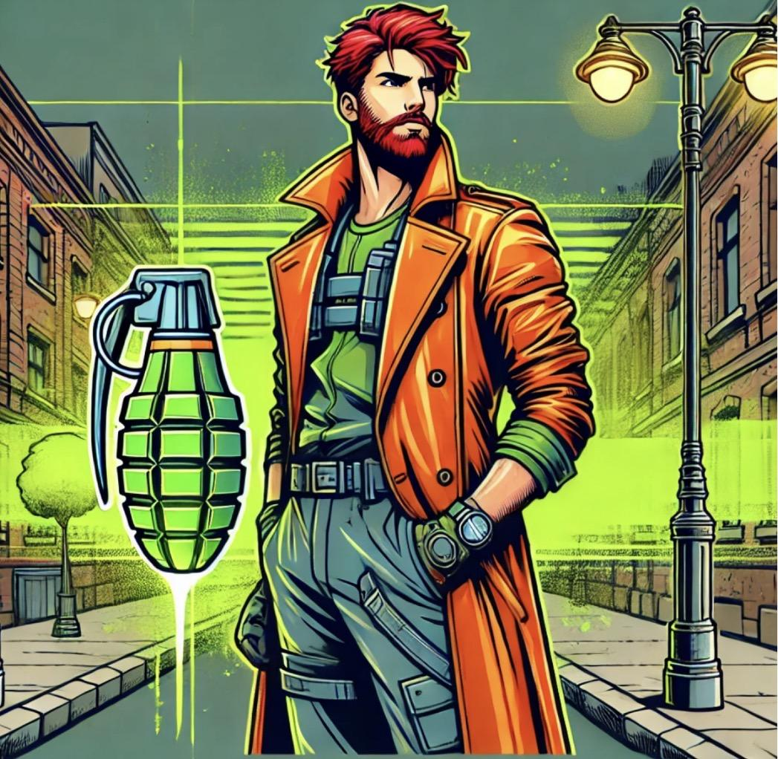
Mr Unemployable
Main Attack: What goes forth
Throws random objects from his inventory at enemies. If he misses, they stay on the ground
Ability 1: Must come back
When triggered, all items thrown zip back to him
Ability 2: Big Ol Boomerang
Throws a big ol boomerang that doesn’t come back
Super: Vape Juice Storm
Rapidly chucks balls of radioactive vape juice around himself while simultaneously retracting them, creating a whirlwind of vape juice

Slide 4
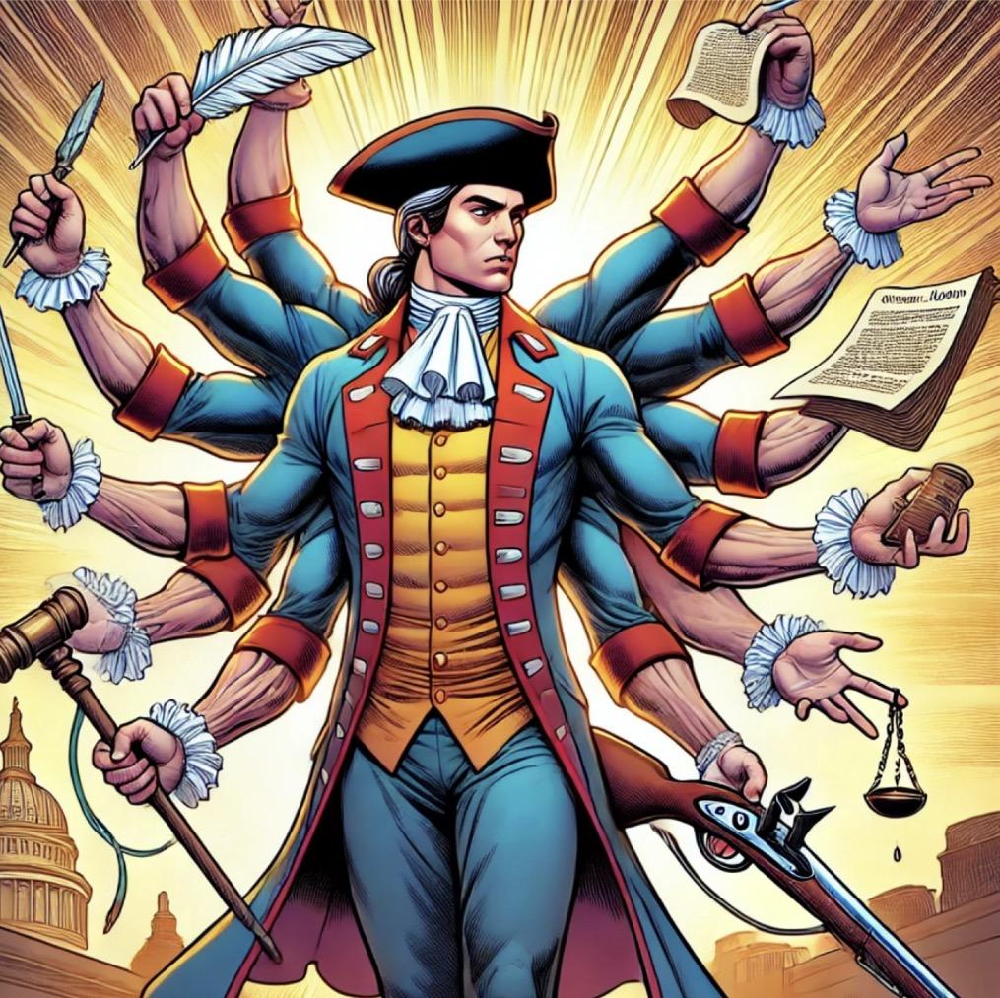
James Madison
Main Attack:
Ability 1:
Ability 2:
Super:

Slide 5
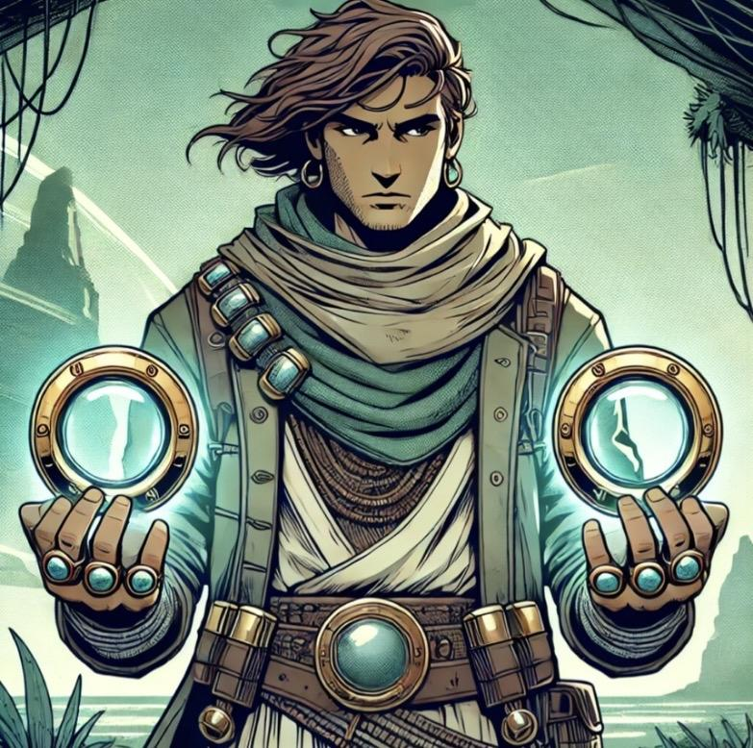
Porthole
Main Attack: Porthole throw
Throws a porthole forward
Ability 1: A Hole new world
Porthole drops a porthole on the ground, slipping through it and popping back out 3 meters behind
Ability 2: Portastic Port-mine
Porthole drops a Porthole on the ground. The porthole is invisible to enemies, and slows them on contact (3 uses)
Super: Underwater Genie
Porthole summons Kneckakeckafallapulu, the underwater genie. He grants porthole one of three wishes, lasting for 20 seconds
True Glass Form: Porthole’s shots reveal enemies and deal double damage
True Metal Form: Porthole’s shots explode and deal area damage
True Porthole Form: Porthole’s shots bounce between enemies

Slide 6
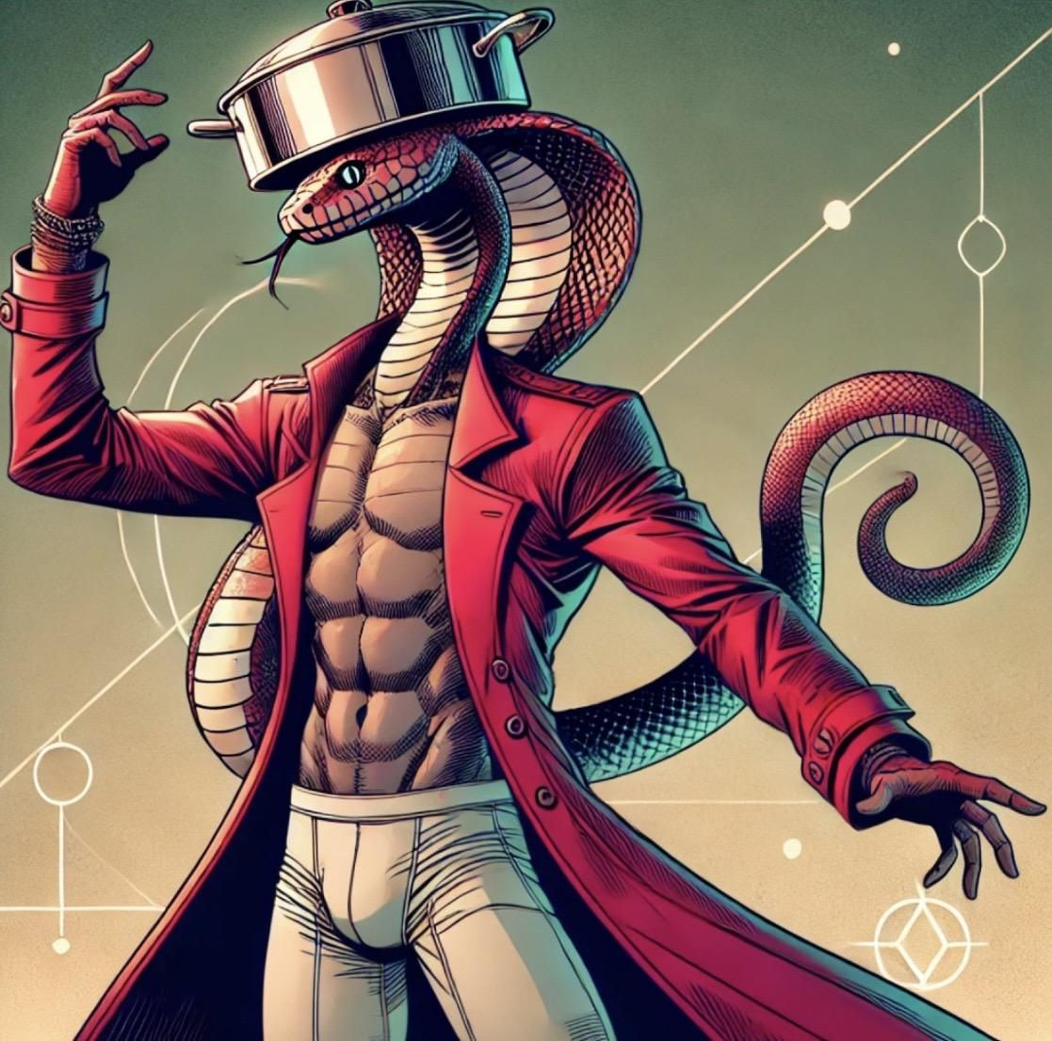
Bitey Whiteys
Main Attack:
Ability 1:
Ability 2:
Super:

Slide 7
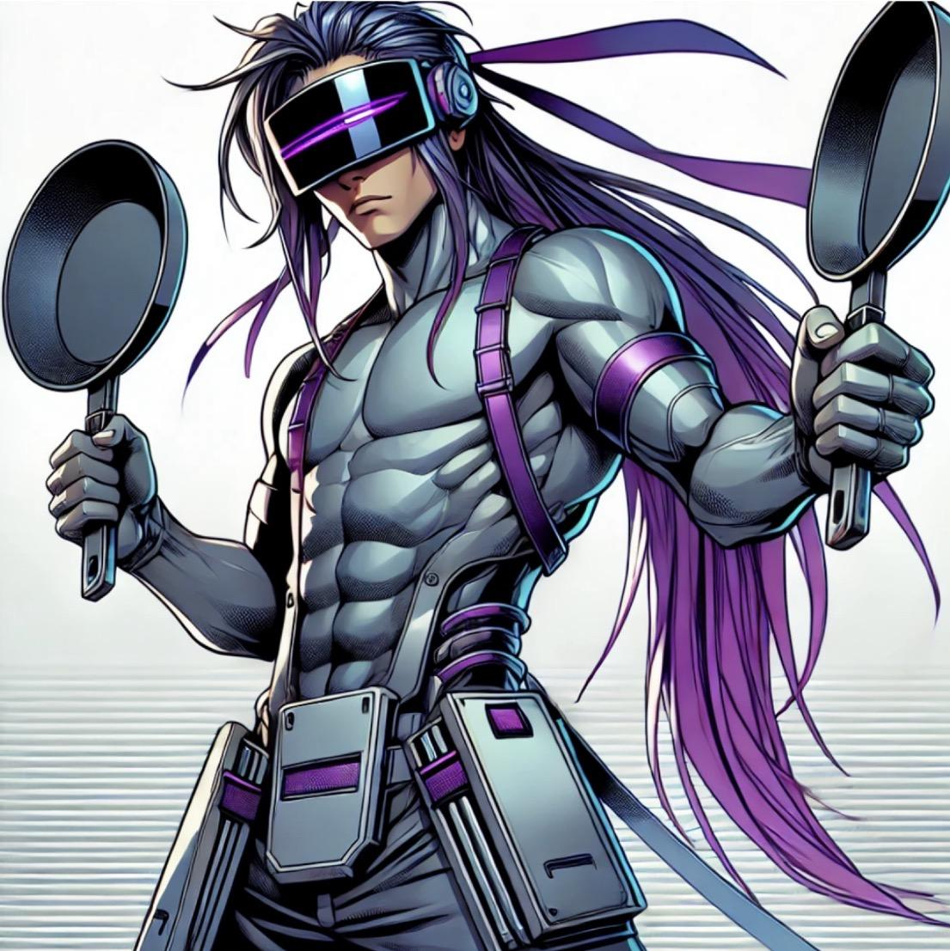
Iron Pan
Main Attack:
Ability 1:
Ability 2:
Super:

Slide 8
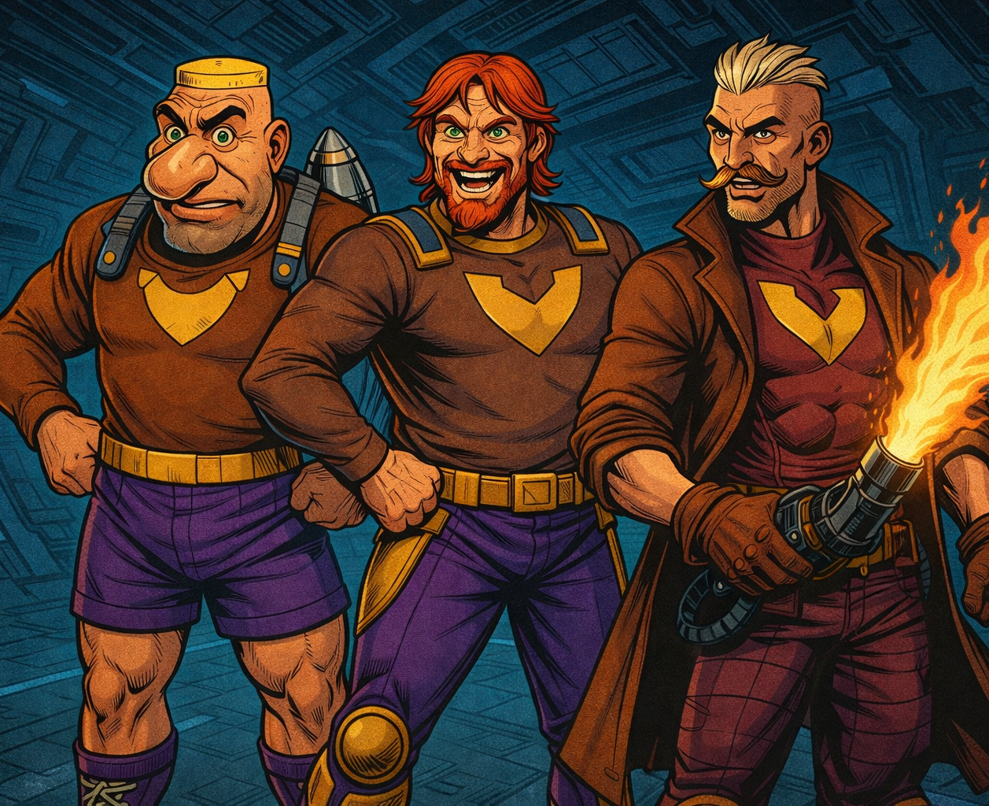
The Triplets
Main Attack: Flap, Tackle, and Glop
Footrun flaps his arms, Jetplace tackles forward and Junkrat shoots some fiery glop outta his crotch
Ability 1: Switcherooski
Switches to the next Triplet
Ability 2: Character Development
Footrun dashes forward, becoming invisible for a few seconds (2 uses). Jetplace uses his portals to teleport behind an enemy. Junkrat fires some larger missiles outta his crotch.
Super: Into the Jetplace!
The triplets unite, joining hands and summoning a giant jetpack. They fly around the map dropping rockets outta his crotch and destruction.

Slide 9
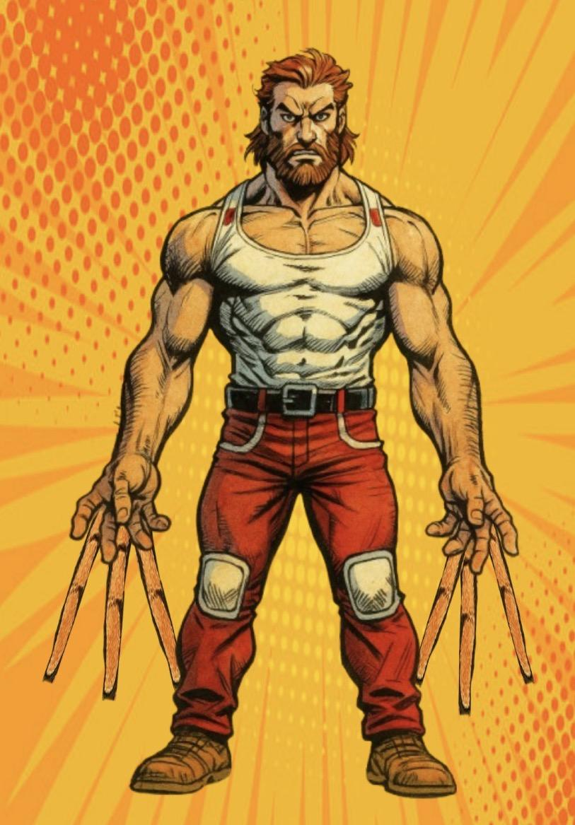
Tickle Monster
Main Attack: Tickle
Tickle
Ability 1: High 8
Tickle Monster absolutely slaps somebody twice, first with the first five and then with the second 3
Ability 2: Enhanced Peeling
Can remove negative effects from himself and his teammates for a small amount of time
Super:

Slide 10
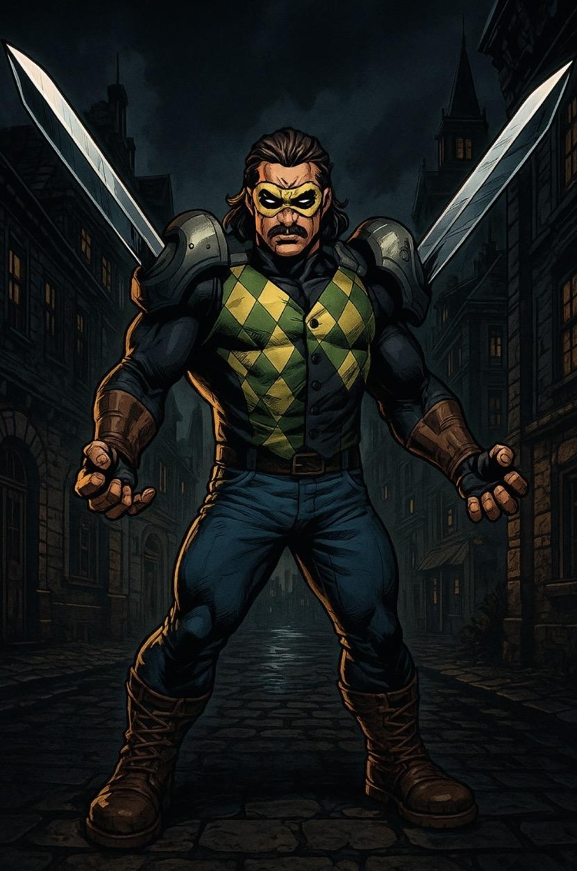
Shoulder Blade
Main Attack:
Ability 1:
Ability 2:
Super:

Slide 11
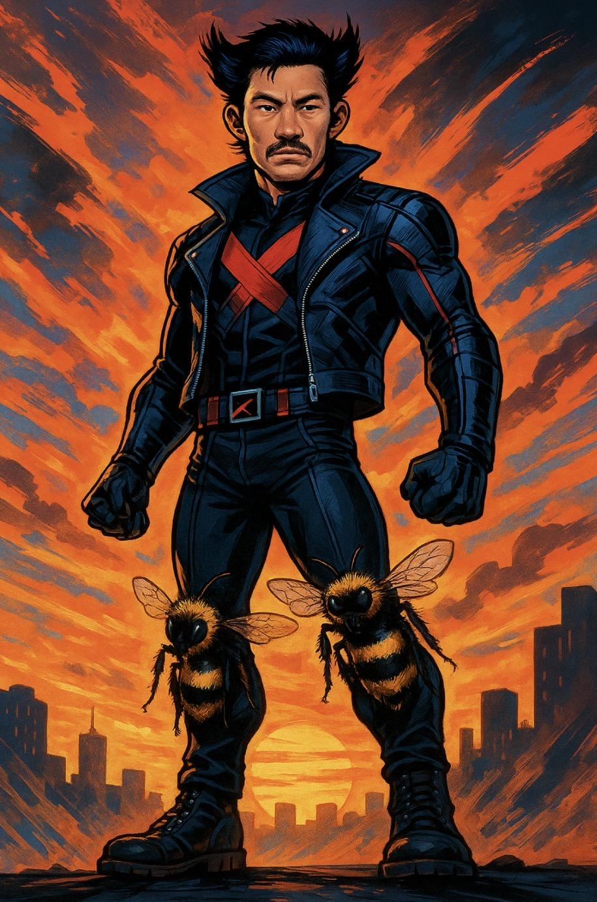
Bee’s Knees
Main Attack: Knee Combo
Kicks in a wide range, knees forward
Ability 1: Flying Bee Drop
Jumps in the air and slams down with his knees forward, stinging enemies
Ability 2: Float like a Butterfly
Send a gust of air forward, creating an area of zero-gravity to trap enemies in
Super: Sting like a Knee
Launches rapid-fire stingers from his knees that poison enemies

Slide 12
Defenders

Slide 13

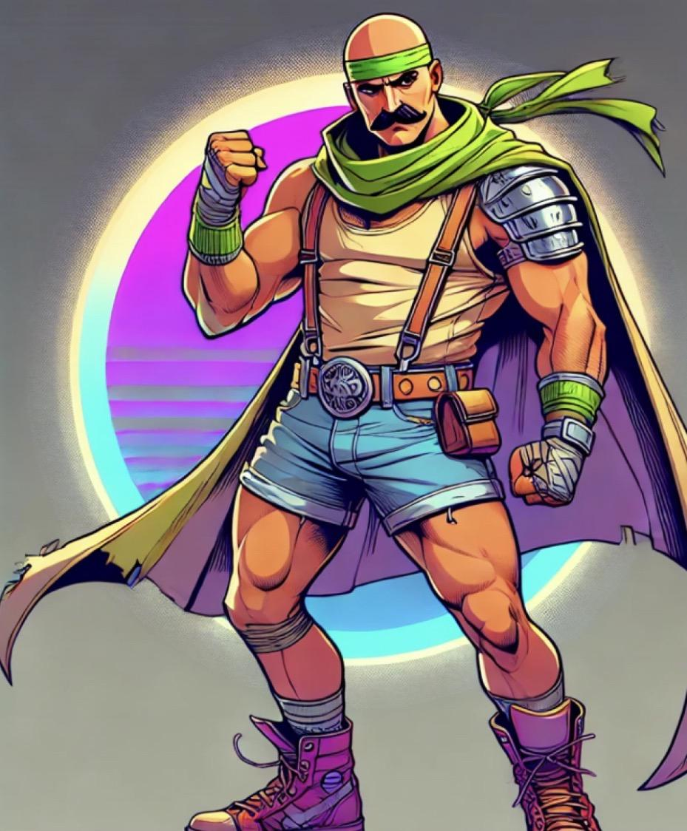
Handfoot
Main Attack: Fantastic Fist-Feet Flurry
A 4-hit combo where he punches and kicks
Ability 1: Hands become feet
Switches around his hands and feet, becoming more than just a man (also increases attack damage).
Ability 2: You’ll never know
Handfoot switches his hands and feet so fast that he absorbs projectiles
Super: Flick’a the Wrist
Handfoot enters flowstate, whirling hands and feet so fast while moving forward. He becomes an unstoppable juggernaut of damage and health

Slide 14
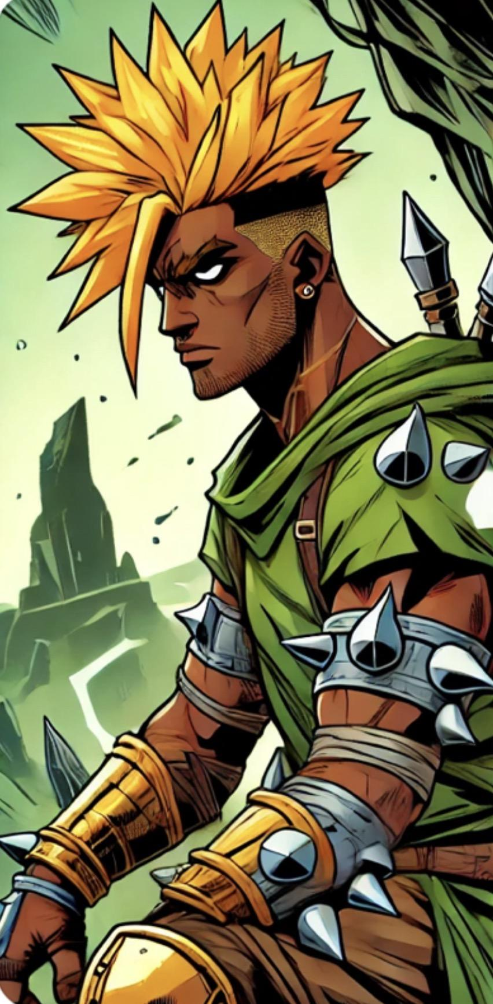
Floss
Main Attack: Who Spiked the Punch?
Floss punches, spikily
Ability 1: Absorption
For the next 10 seconds, Floss takes 1/3rd of damage from projectiles
Ability 2: Tease and Joke
Floss gets demoralized by the other team for sucking, drawing their attention and firepower to him
Super: Big Spike Thing
The Great Gatsby shoots Floss in the chest with a big spike thing. But then Floss shoots it back super fast out of him and it explodes
Passive: Flossback
Enemies take 1/32nd of all damage they inflict on floss via projectiles

Slide 15
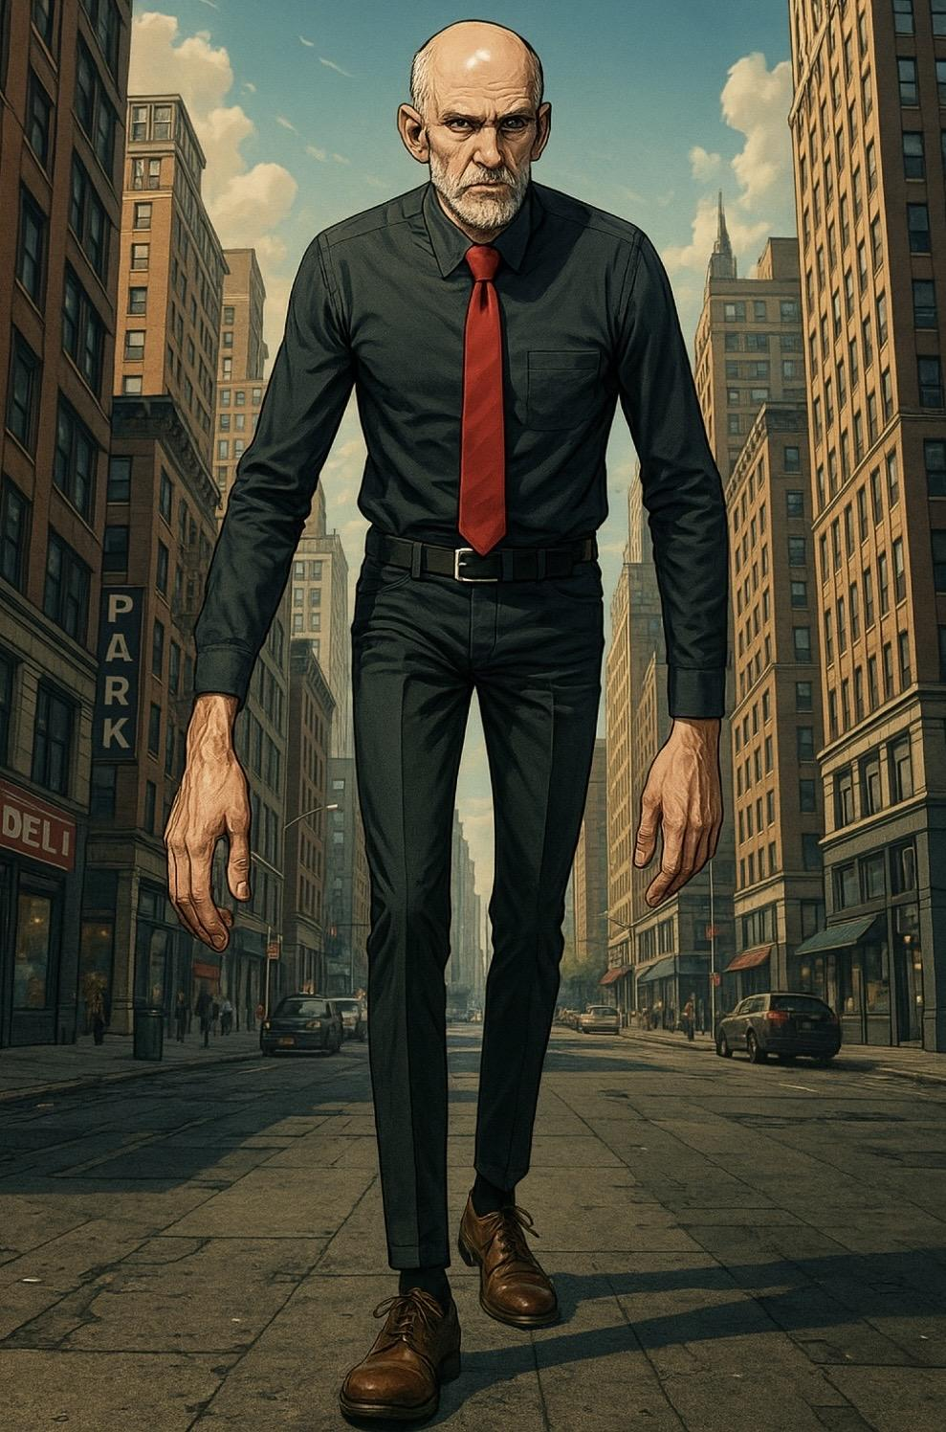
Man Guy
Main Attack: Man Punch
Man Guy punches with his long arm like a ma
Ability 1: Self Harm
Man Guy deals damage to himself, increasing his attack
Ability 2: Super Bones
Man Guy boosts his bones, taking less damage for the next three secs
Super: Guy Kick
Man Guy does a big kick,l that breaks his leg if he hits it he can do it again with more damage
Passive: Manliness
Man Guy fans increased max health whenever he takes damage, it resets when he dies

Slide 16
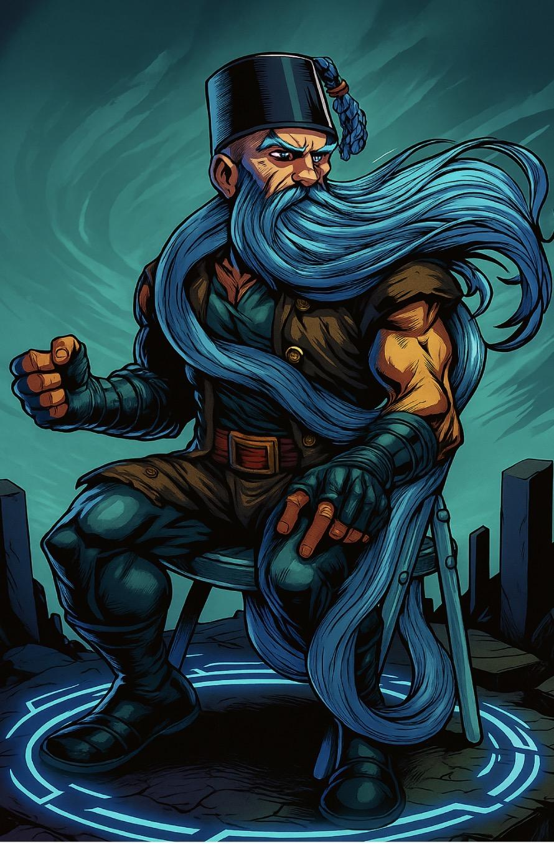
Chair Beard
Main Attack:
Ability 1:
Ability 2:
Super:

Slide 17
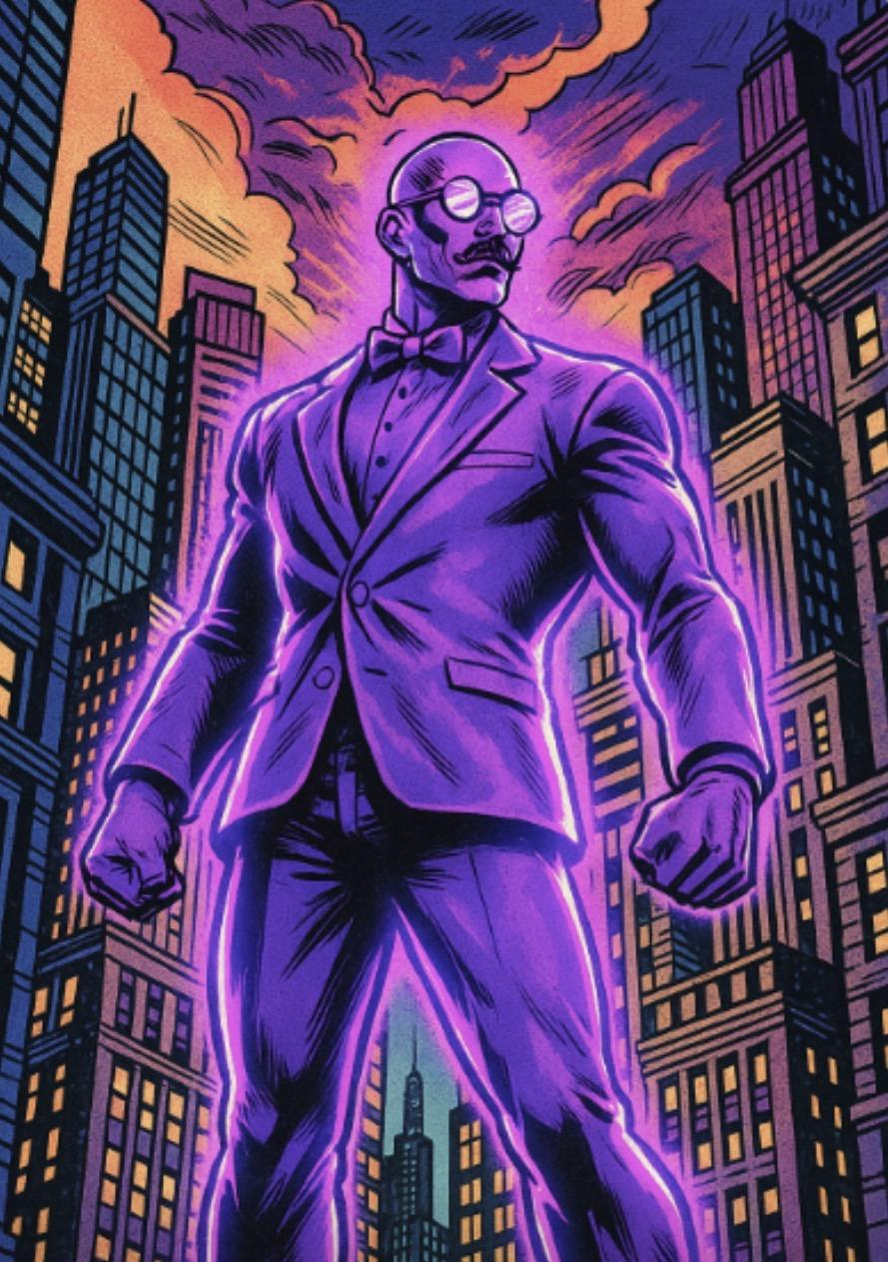
Ultraviolet
Main Attack: Ultraviolet Umbrella
Ultraviolet stabs with his umbrella, then opens it creating a small shield for 1 sec
Ability 1: Lavender Lash
Ultraviolet blinds the nearest enemy with his purpleness, blinding them
Ability 2: Mount the Indigoat!
Ultraviolet mounts the indigoat, gaining increased health and speed for 5 secs
Super: Purpleness Explosion
Ultraviolet shines his purpleness, gaining a shield and taunting all nearby enemies into attacking him

Slide 18
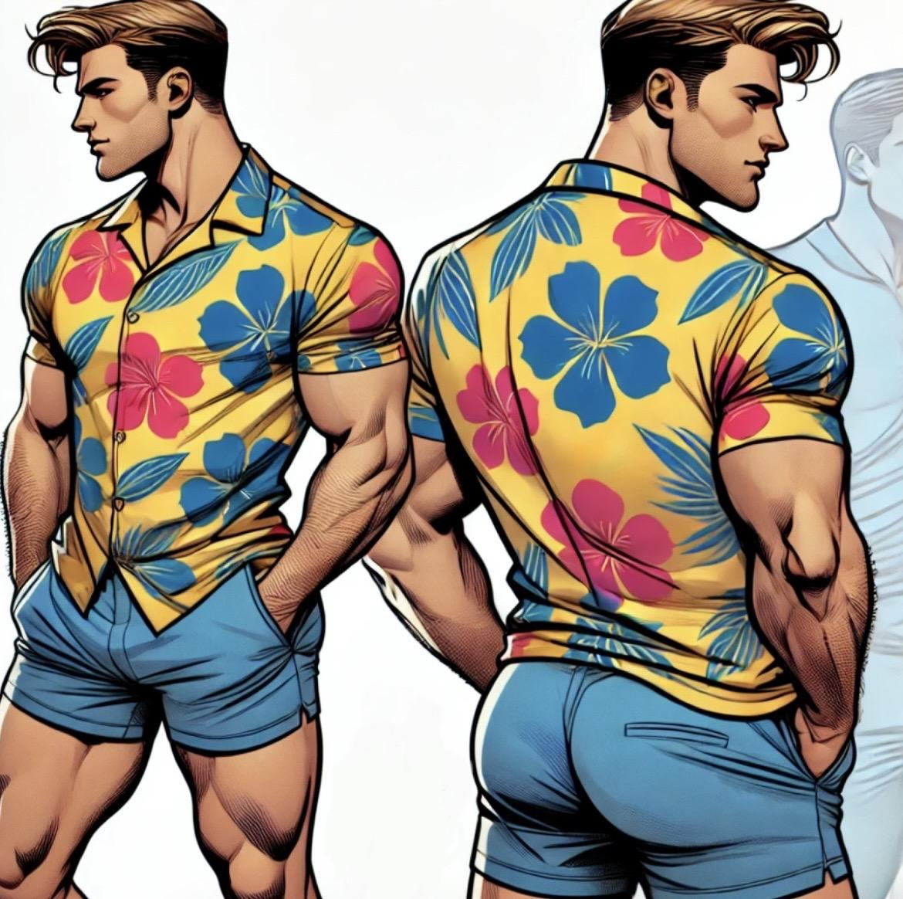
Guy Yacht
Main Attack: Squirt Gun
Guy Yacht fires high pressure water from his squirt gun
Ability 1: Bomboclat
Guy Yacht flexes his cheeks, taking 80% less damage from behind for a 5 seconds
Ability 2: Eyes up here
Guy Yacht launches into the air and lands on his butt, buffing the defense of allies he lands around
Super: Fantastic Plastic
Using the plastic in his veins, Guy Yacht hardens his entire body, taking overwhelmingly less damage from all sources

Slide 19
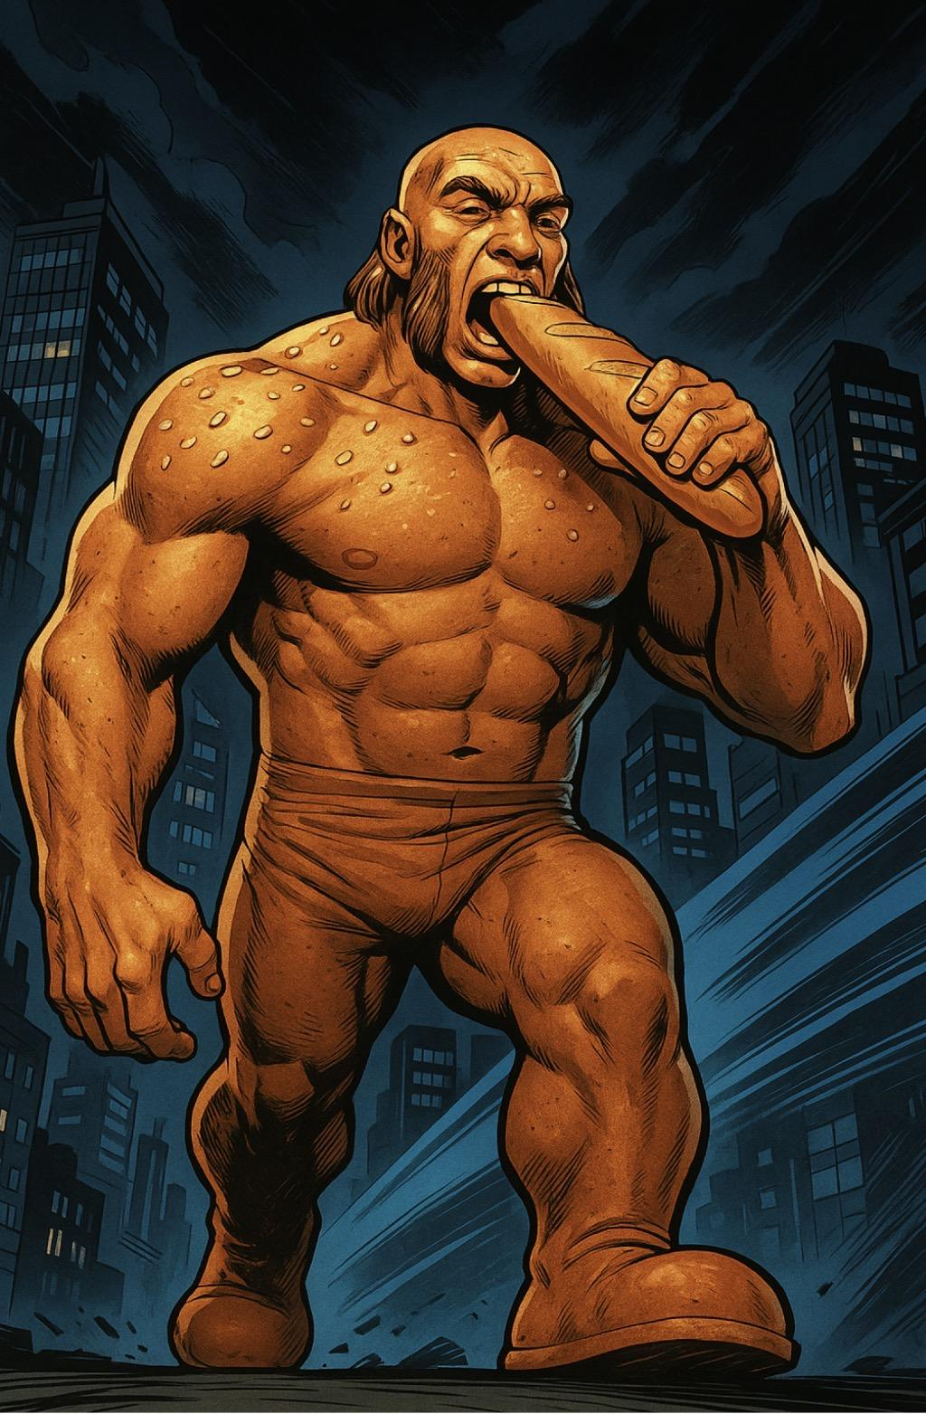
Yeast
Main Attack:
Ability 1:
Ability 2:
Super:

Slide 20
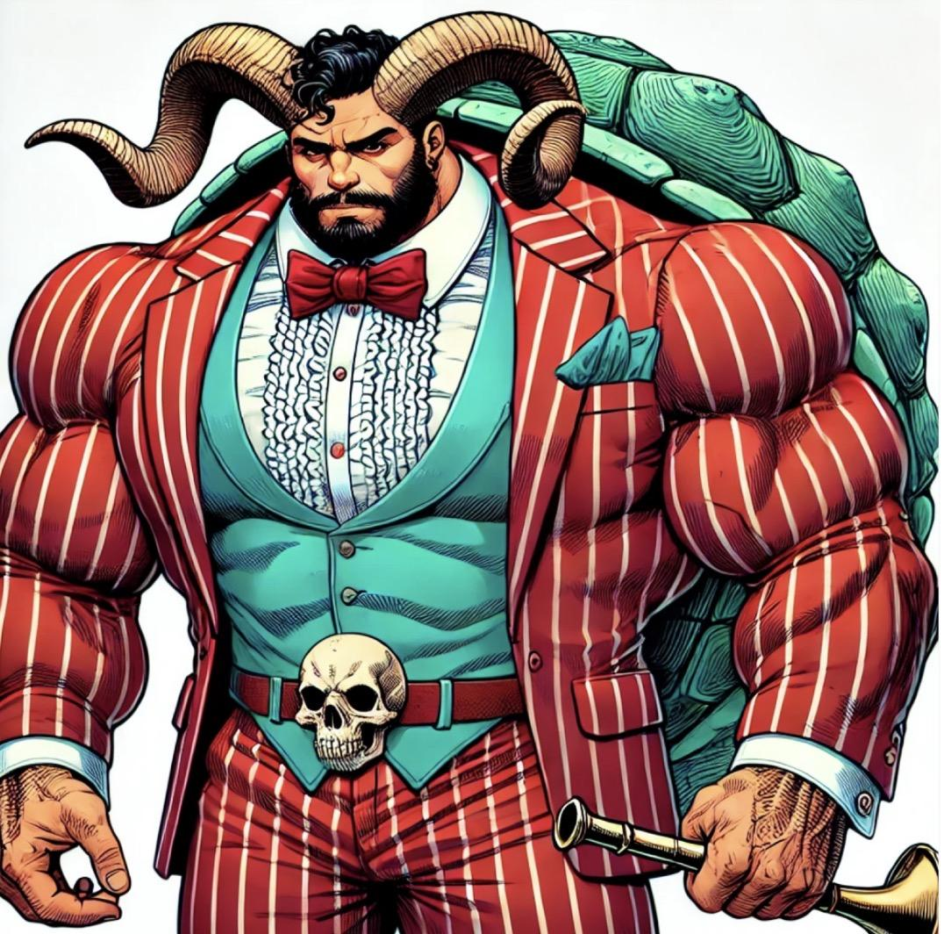
Captain Trumpet
Main Attack: Clawsini Gatini
Captain trumpet scratches twice with cat claws
Ability 1: Shellala Shellalo
Captain Trumpet gains a shield for 5 secs
Ability 2: Rameo Chargeo
Captain trumpet dashes forward with his ram horns
Super: Trumpets Sounding
Captain trumpet Gains a health boost and a random animal buff:
-Bunnini - Super jump
-Peacocko - Taunt at full health
-Sovereign Snakearms- Main Attack poisons

Slide 21
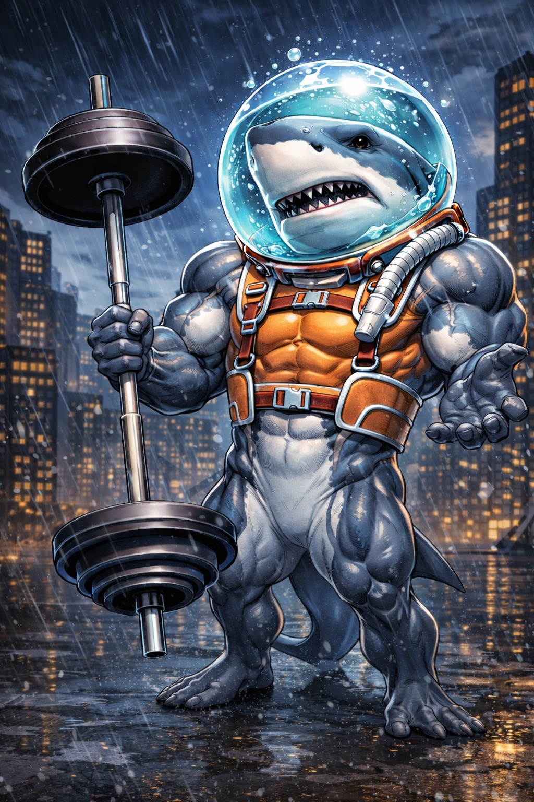
Gym Shark
Main Attack: Barbell strikenado
Ability 1:Bulgarian tail squatnado
Ability 2: Sharknado
Super: ROIDNADO
Swims under ground and eats one person

Slide 22
Saboteurs

Slide 23

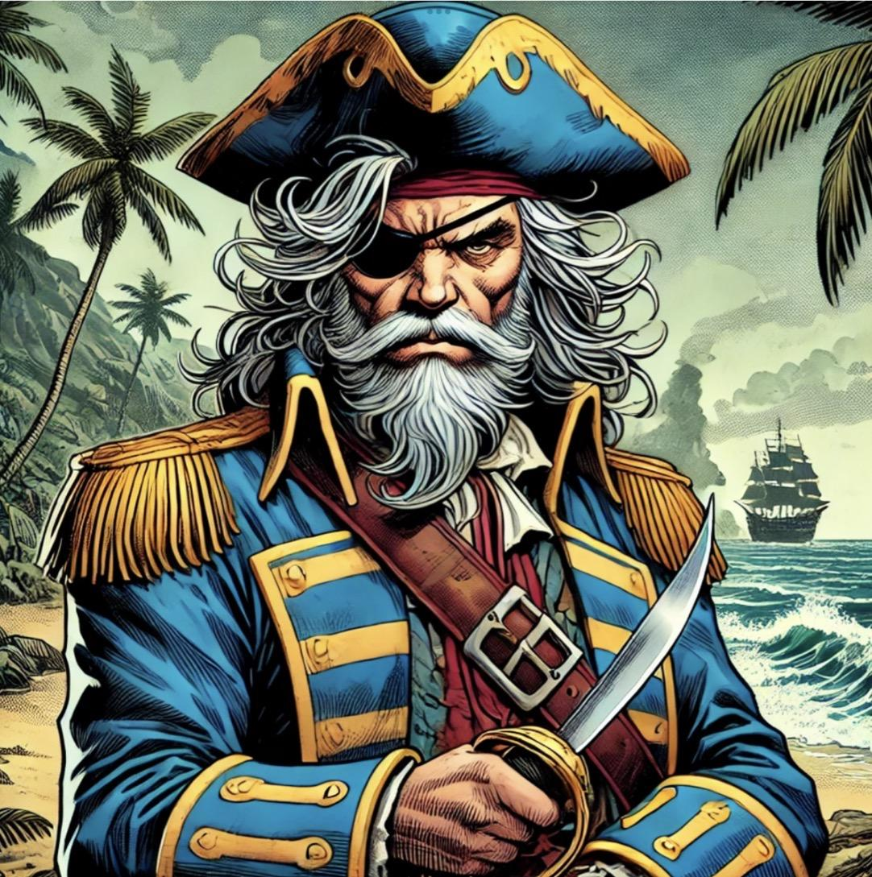
Captain Crunch
Main Attack: Get you by the Knife
Captain Crunch Stabs enemies with his knife
Ability 1: Oops all berries
Captain Crunch spills berries on the ground, slowing enemies around him
Ability 2: Crunch Surprise
Captain crunch hides in a bush, and his next knife has a dash and does extra damage
Super: Take you to his special island
Captain crunch Takes himself and the nearest enemy to his special island for 10 secs, where he has increased stats

Slide 24
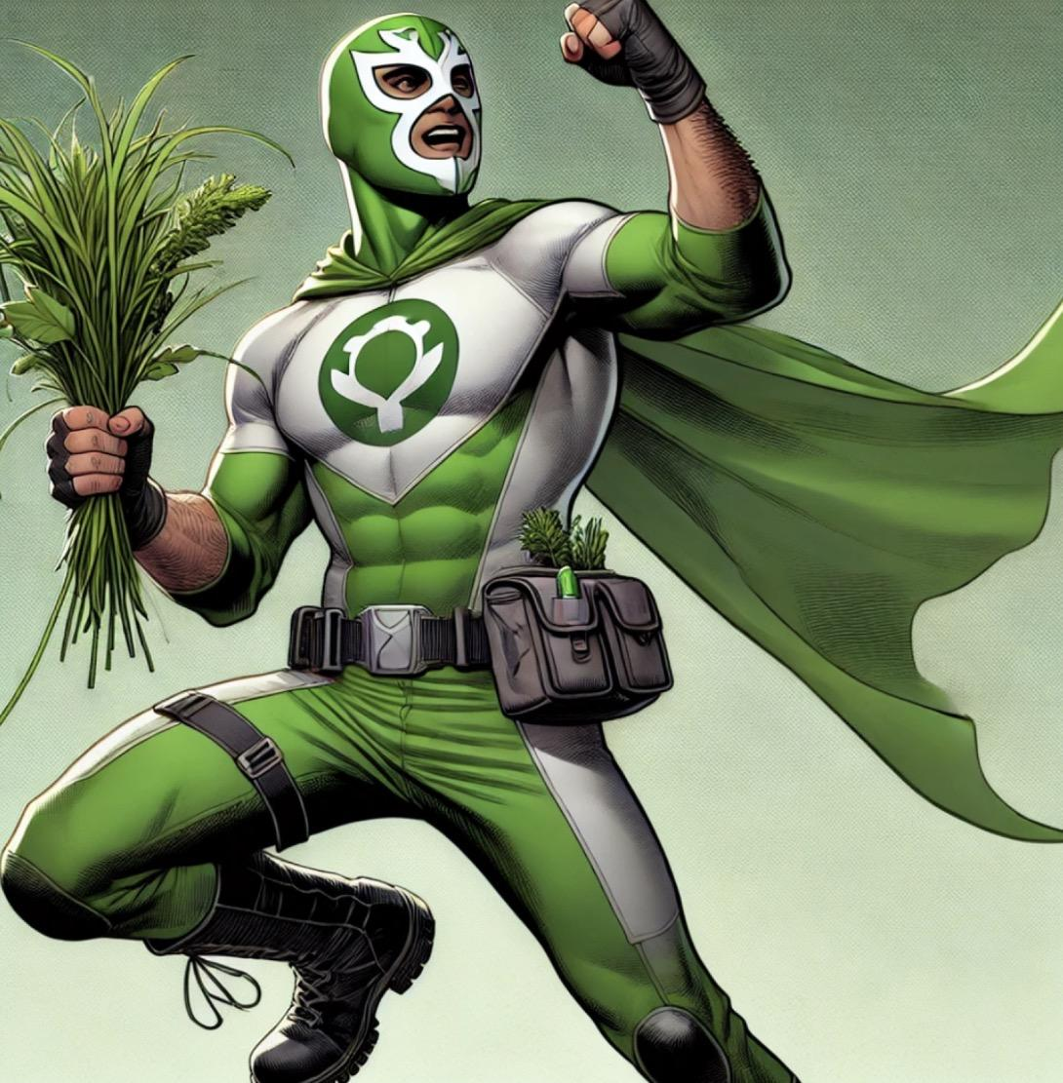
Jonnakiss
Main Attack: Grass Throw
Jonnakiss throws grass, dealing more damage the closer the enemy is
Ability 1: Sharp Grass
Jonnakiss sharpens his grass so that it does max damage at all distances for the next three throws
Ability 2: Thundercloud mode
Jonnakiss quickly becomes a cloud then immediately shoots down in a lightning bolt, dealing massive damage
Super: Eat the grass!
Jonnakiss eats his grass, turning him into a invincible cloud for 15 seconds, he comes down on the ground as it snows slowing enemies in his area

Slide 25
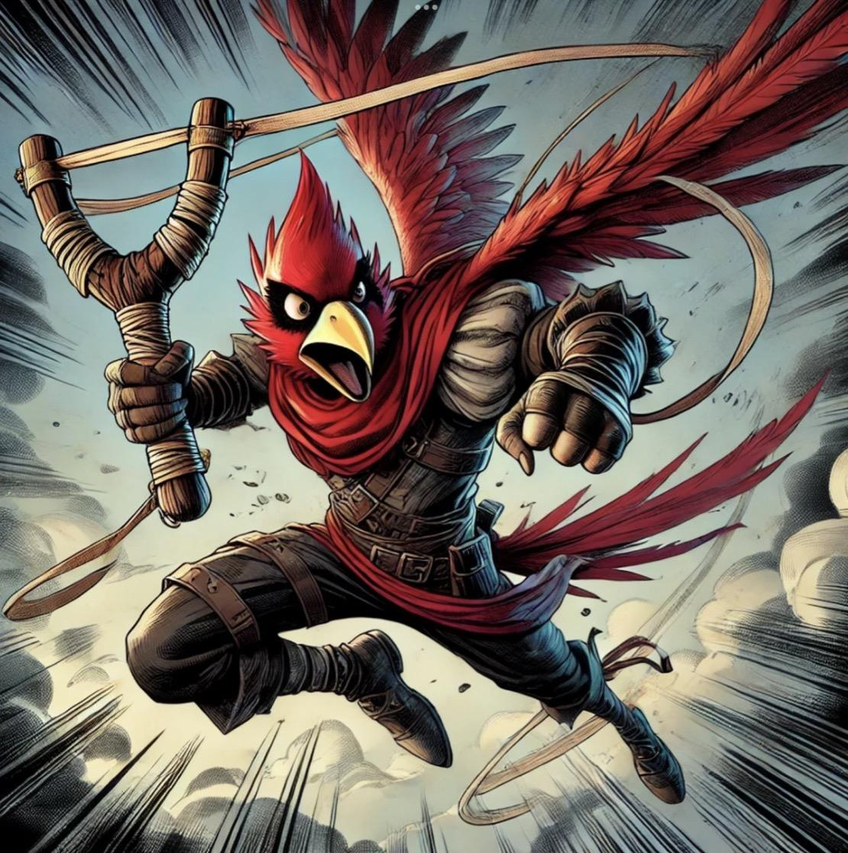
Displeased Avian
Main Attack: CAW CAWWWW
A rapid, short range peck with infinite ammo
Ability 1: WAAAA HEEYA
Red flings himself to a designated area with his slingshot, stunning enemies on land
Ability 2: WOOOIA UUU UU UYA
Red slices in a wide berth with his wings, doing 50% of the max health of the squishiest enemy caught.
Super: AAAAAAIIIIIIIIAAA
Red perfectly mimics the sound of a bird, frightening Big Pig and sending him on a rampage through the map

Slide 26
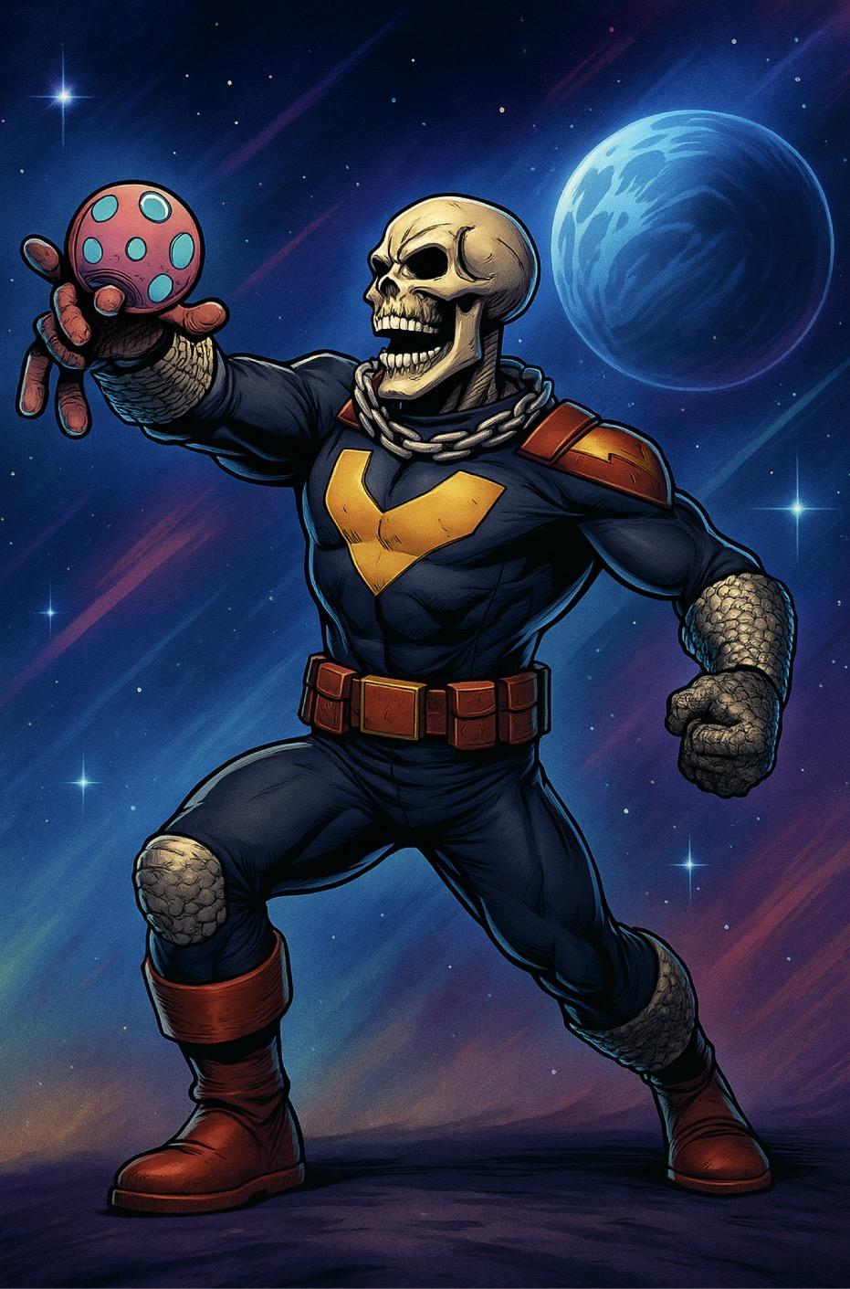
Voodude
Main Attack:
Ability 1:
Ability 2:
Super:

Slide 27
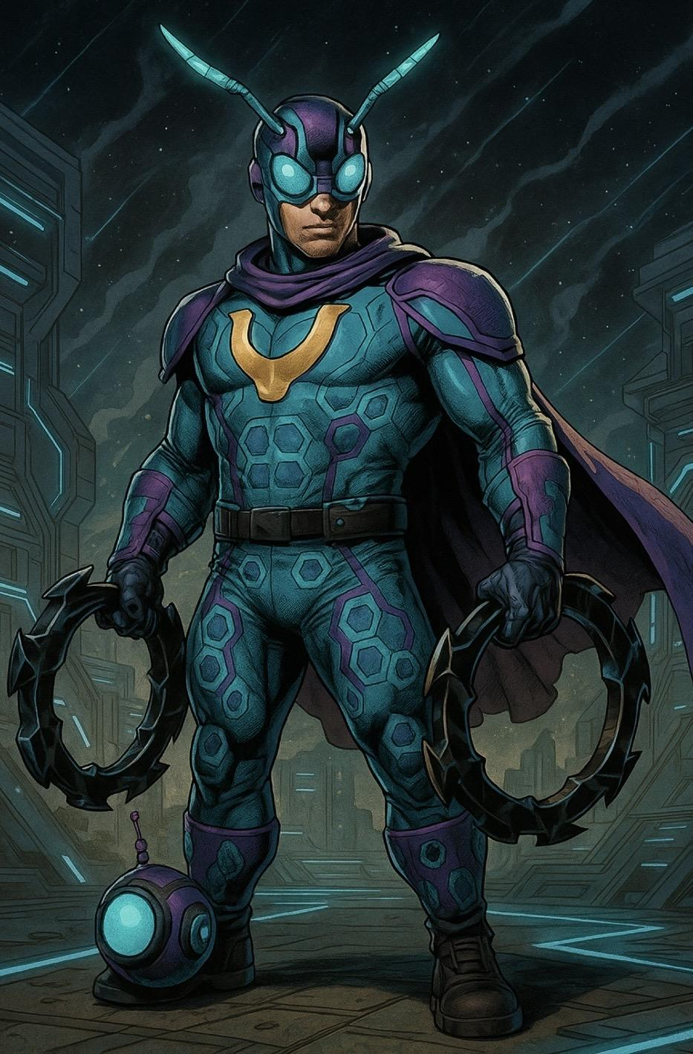
MU†E-ÅNT
Passive: Mute
Mute-Ant can’t communicate with teammates
Main Attack: Ant-Rings
Mute-Ant throws one of his ant-rings a short distance
Ability 1: Ant-Bot
Ant-Bot scans the area around him, revealing hidden objects and zapping enemies
Ability 2: Ant-friend
(In ant-form) Mute-Ant gets carried around by his insect friend; Señor butterfly, allowing him to fly for 8 secs
Super: Ant-Man
Mute-ant speaks for 10 seconds transforming him into an ant that is so tiny it is invisible

Slide 28
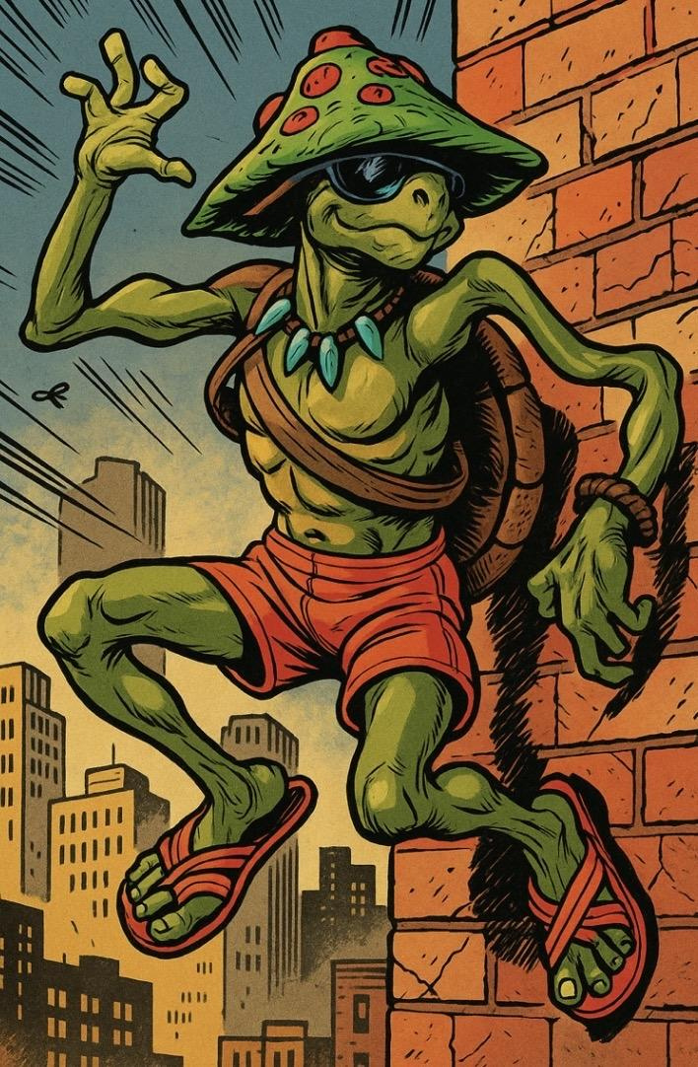
Contortoise
Main Attack:
Ability 1:
Ability 2:
Super:

Slide 29
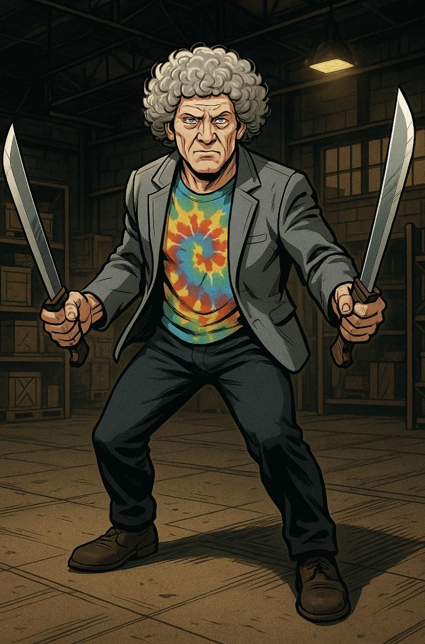
Machete Man
Main Attack: Machete
Machete Man slashes with his machete
Ability 1: Machete Throw
Machete man throws his machete then backflips to get a new one
Ability 2: Dementia Machete Backflip
Machete man does a backflip and has 50 chance of dealing a ton of damage to himself or an enemy
Super: Old Guy Backflip
Machete man does a backflip, gaining an extra Mach e, extra damage and extra speed

Slide 30
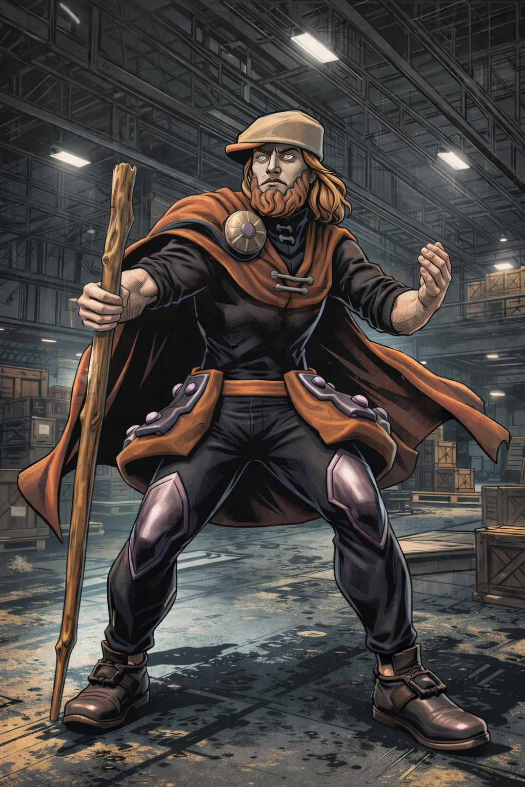
Grup Scrooge
Main Attack:
Ability 1:
Ability 2:
Super:

Slide 31
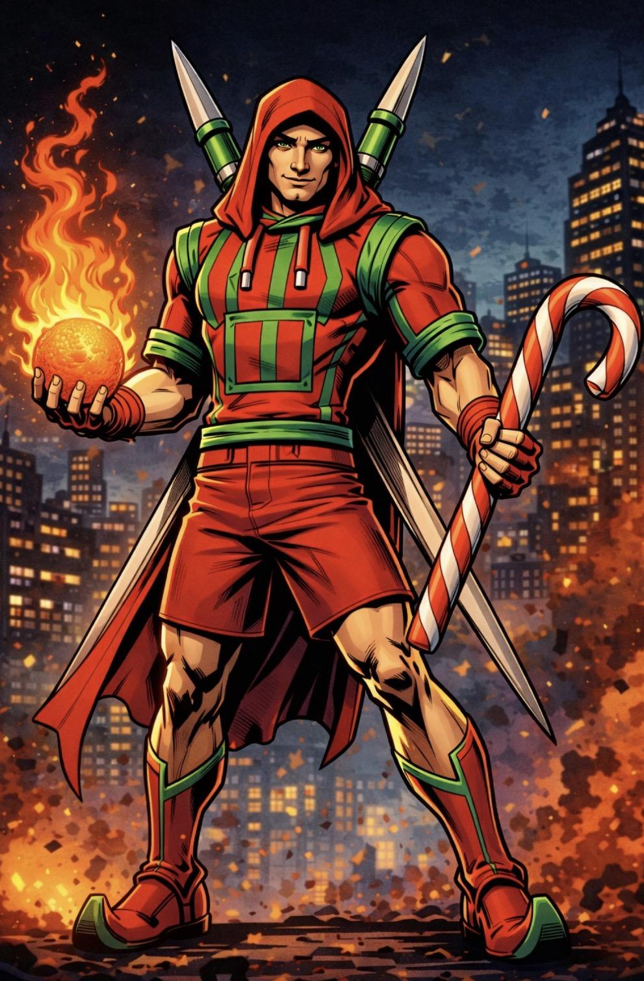
Captain Christingle (Seasonal)
Main Attack:
Ability 1:
Ability 2:
Super:

Slide 32
Supporters

Slide 33

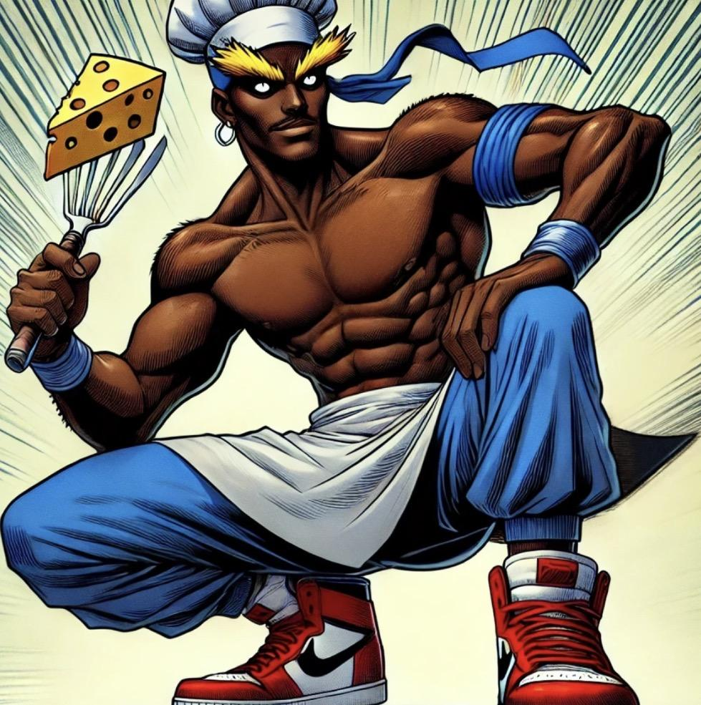
Burger King
Main Attack: Double Spatula Surprise
Burger King makes burgers, LT to make funky burgers for teammates, RT to make evil burgers for enemies.
Ability 1: The Great
Burger King makes a big burger, providing cover for teammates and can be consumed for health.
Ability 2: The Gatsby
Burger King draws a spatula circle, creating a burger zone for teammates to gain increased attack in.
Super: The Great and The Gatsby
Burger King Greats a Gatsby Burger, turning any teammate into the Great Gatsby for 1 minute. While the Great Gatsby, teammates have much more health and damage.

Slide 34
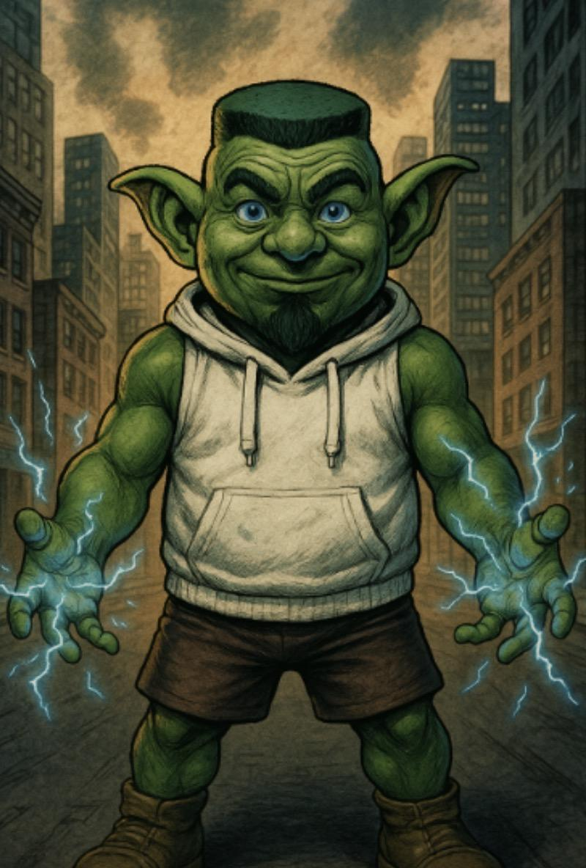
Defrilibatorator
Main Attack:
Ability 1:
Ability 2:
Super:

Slide 35
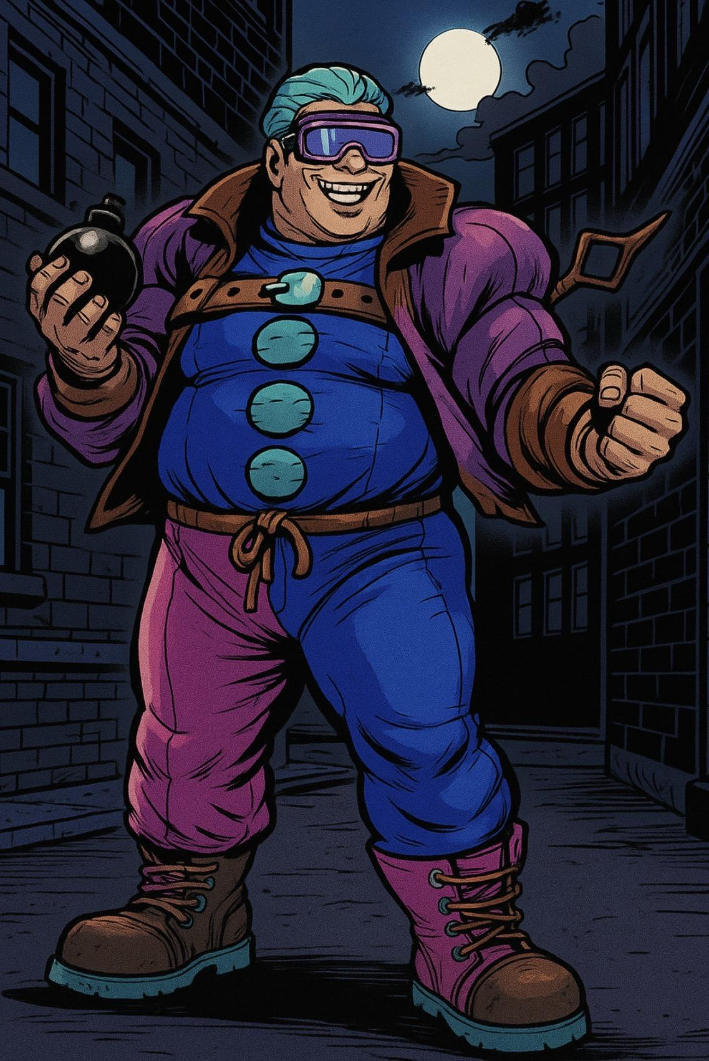
Brain Freeze
Main Attack: I’m Not Having Fun
Brainfreeze, shocked at the prospect of not fun, swings out with a one-handed punch, gaining Fun on hit.
Ability 1: Use the Bomb (costs 2 Fun)
Brainfreeze finally uses the bomb he always carries around, dealing small splash damage.
Ability 2: You Fly When I’m Having Fun (costs 1 Fun)
Brainfreeze can levitate a teammate, healing them and raising them to any height for 5 seconds.
Super: Time Flies When Your Having Fun
Brainfreeze takes a hit of straight Fun, causing himself to enter a state of bliss, summoning Time Flies to tell him and his teammates the time in game and in real life for 30 seconds

Slide 36
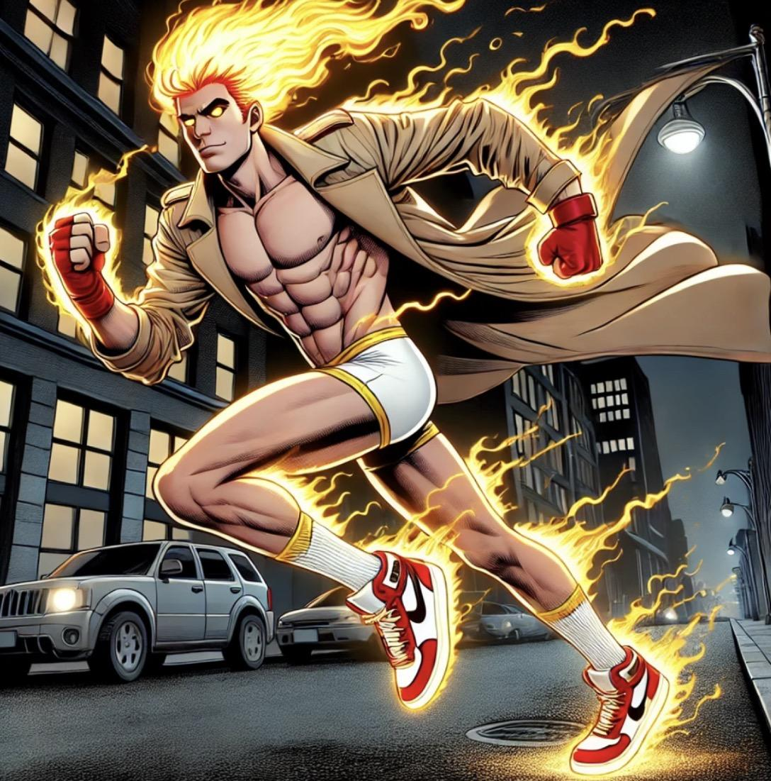
Speedo
Main Attack:
Ability 1:
Ability 2:
Super:

Slide 37
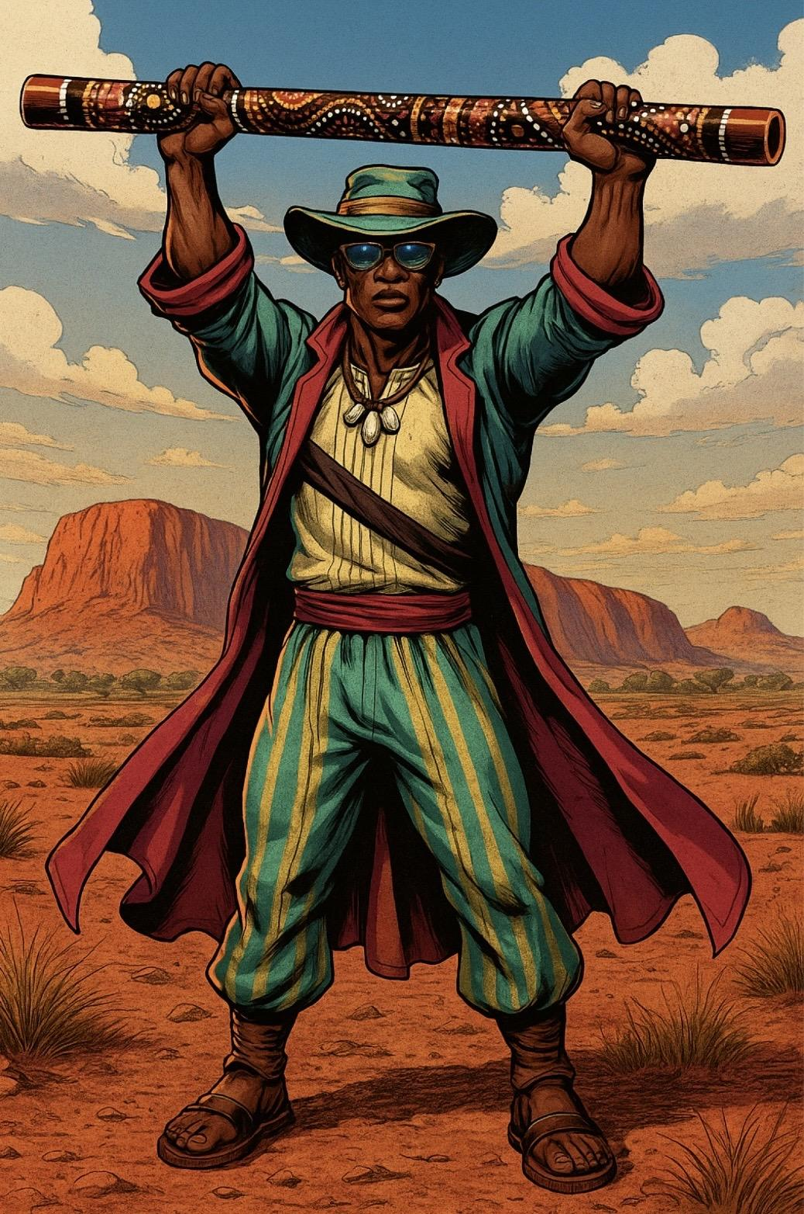
Didgeridon't
Main Attack: Didgeridon't Come Near
Didgeridon't swings his Didgeridon't in a wide arc, causing fall damage on hit.
Ability 1: Didgeridon't Mess Around
Didgeridon't stretches his arms, increasing super charge rate for 5 seconds.
Ability 2: Digerididn’t and Digeriwon’t
Didgeridon't summons the ghosts of Digeripast and the ghost of digerifuture to perform a line dance. They are solid and can block attacks.
Super: Didgeridon't Take Fall Damage
Didgeridon't raises his Didgeridon't above his head, and for 15 seconds his teammates don’t take fall damage.

Slide 38
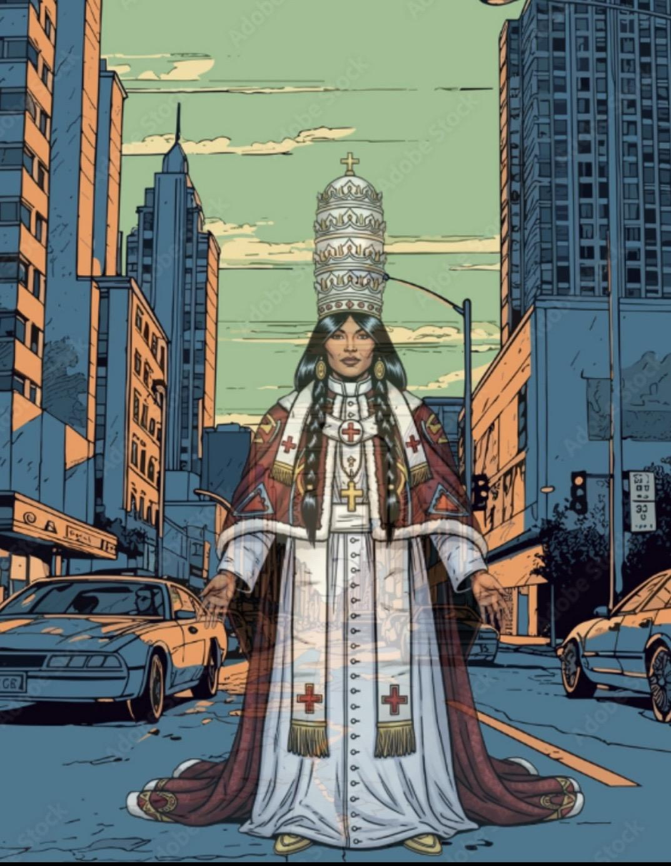
Corn Maiden
Main Attack:
Ability 1:
Ability 2:
Super:

Slide 39
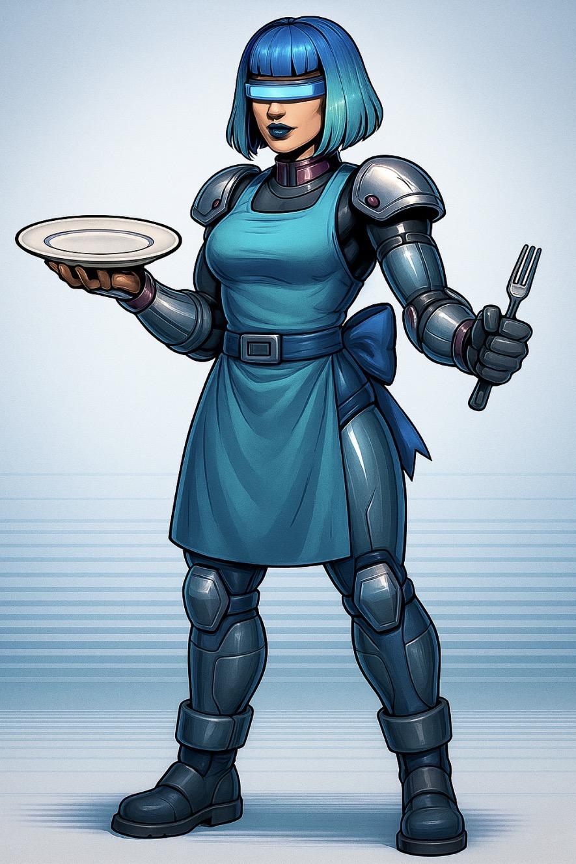
DishwasHER
Main Attack: Womanly Plate Throw
DishwasHER throws a plate in a female-like manner
Ability 1: CassHERole
DishwasHER drops a casserole that heals her teammates
Ability 2: Stealth Mode
DishwasHER goes into stealth mode, getting melee whisk weapons and changing her outfit which does nothing
Super: Do the Laundry
DishwasHER removes all negative effects from her teammates and heals them significantly

Slide 40
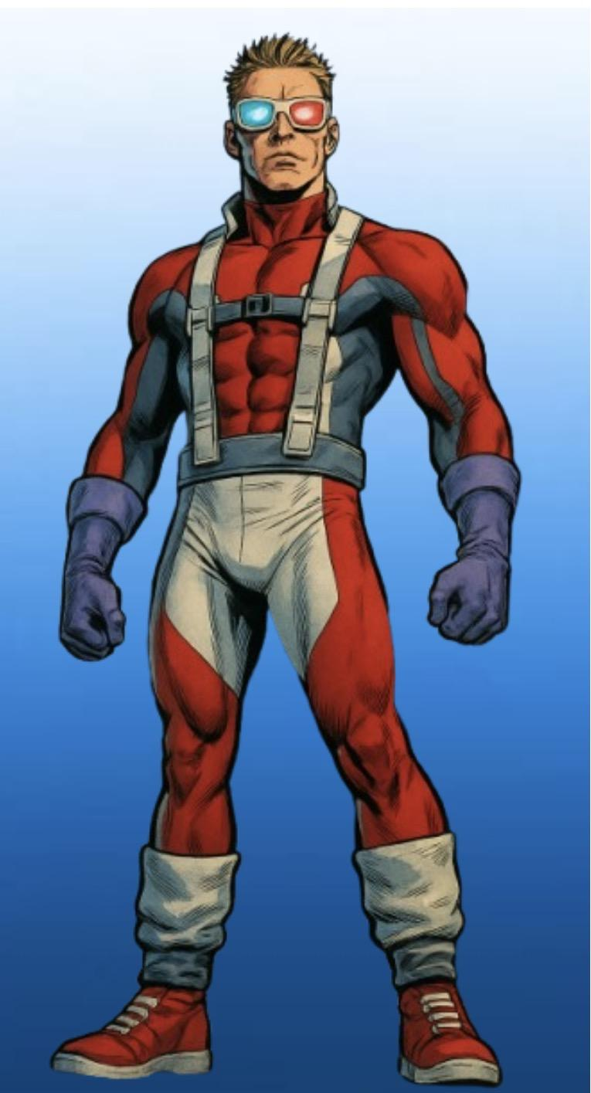
PowerPoint
Main Attack: Laser Taser Blaser Face
Power point shoots a laser at an enemies face. If the enemy is wearing a blaser, it does double damage
Ability 1: Minor Blind
PowerPoint temporarily blinds one enemy, leaving a “blind spot” where they can’t see for 5 seconds
Ability 2: 3rd D vision
PowerPoint sees through the first and the second D’s, and him and his teammates can see enemies wherever they are on the map
Super: Super Distract
Power point summons a random point on the map, and all other characers are sucked towards that point and can

Slide 41
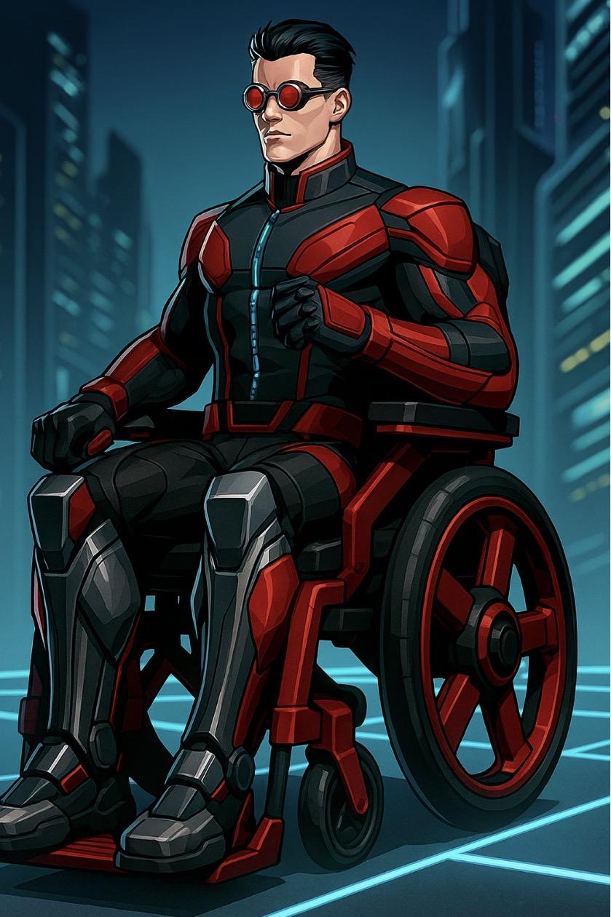
Shan’t Dance
Main Attack: Autissles
Shan’t fires mini-missiles from his wheelchair
Ability 1: Wheelchair Tow
Shan’t attaches his wheelchair to another teammate, significantly boosting their movement speed
Ability 2: Wheel Steel
Shan’t shoots a wheel off of his wheelchair, providing cover for teammates behind them (2 uses)
Super: Motivational JUMP
Shan’t, after charging all game, performs the biggest jump you’ve seen any guy do before. This incredible morale boost gives all teammates in the area incredible jump height, regeneration, and healing over time

Slide 42
Controllers

Slide 43

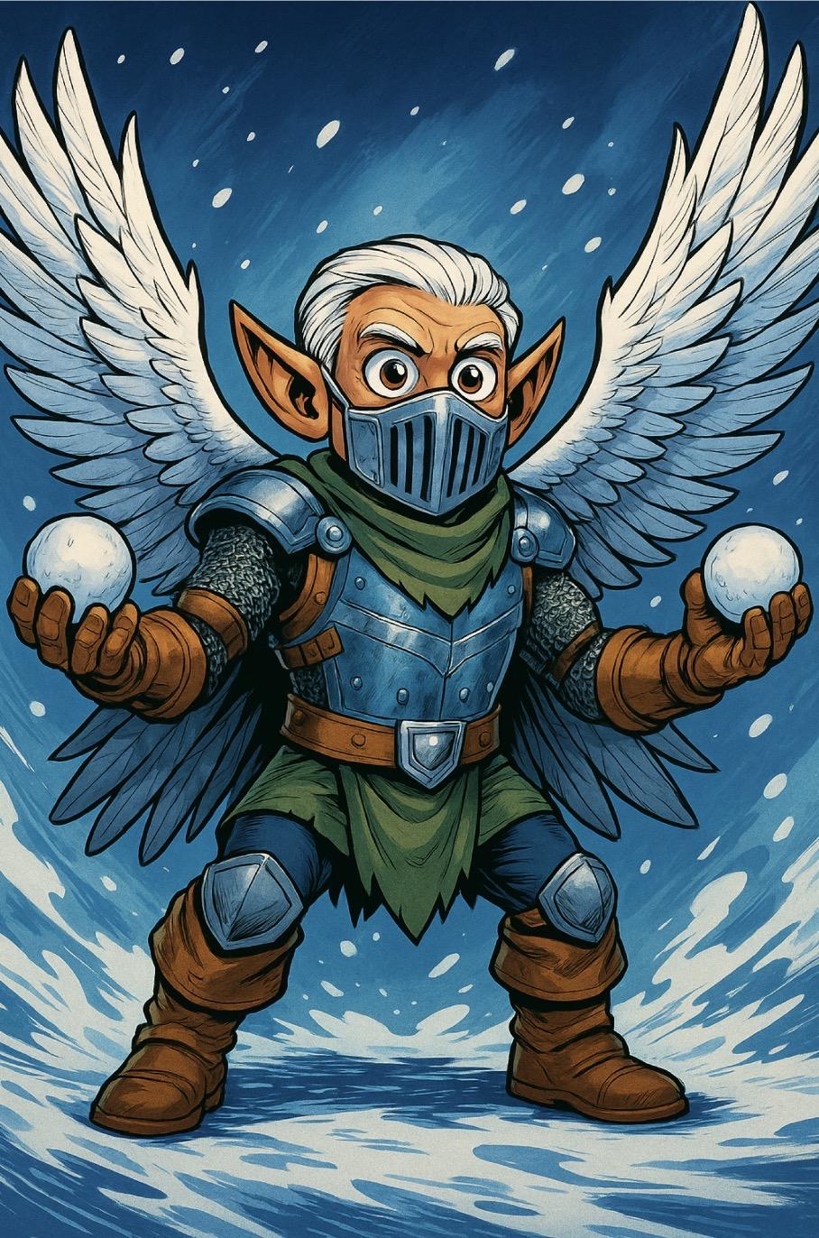
Snow Angel
Main Attack:
Ability 1:
Ability 2:
Super:

Slide 44
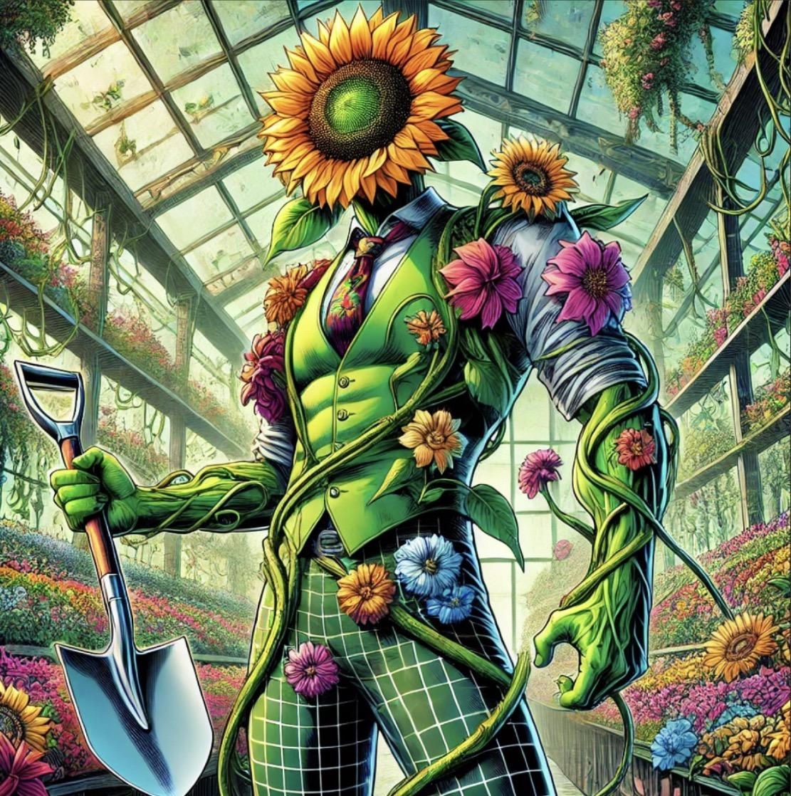
Faceplant
Main Attack: Shovel Slash
Faceplant attacks with shovel, dealing heavy melee damage and launching weaker vines out in front of him
Ability 1: Face full of Plant
Faceplant Excretes a large amount of poisonous pollen from his face
Ability 2: Plant full of Face
Faceplant creates an area of plants who encourage his teammates, giving bonus attack and speed
Super: Plant full of Plant
Faceplant creates an area that wraps enemies up vines, stunning them

Slide 45
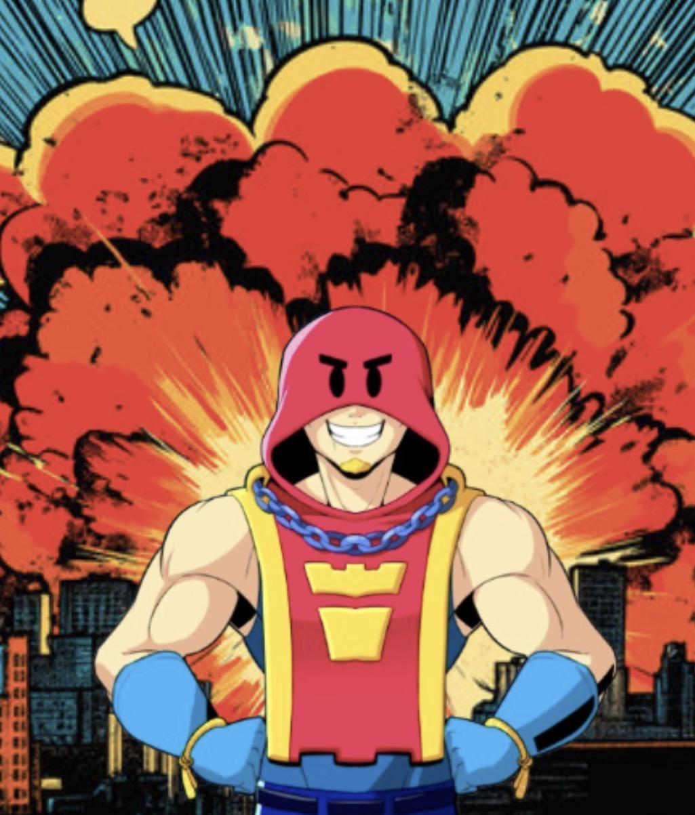
Grom
Main Attack: Bud Go Boom!
Grom throws his walkie-talkie over obstacles at a long range that explodes into four piercing projectiles in a cross pattern. The projectiles travel for 3.33 tiles. An enemy can only be damaged by one of the projectiles. Similarly to Spike's attack, Grom's walkie-talkie always splits perpendicularly to the map borders; the cross pattern doesn't change regardless of the angle Grom is facing. It takes the same amount of time for an attack to land regardless of the distance from Grom.
Ability 1: Watchtower
Upon activation, Grom drops a turret that allows him and allies to see enemies inside bushes in its 10-tile radius. The turret has 1500 health, will be destroyed if Grom deploys another turret, and decays by 75 health per second until it's destroyed, lasting for up to 20 seconds if it doesn't take any damage. Any invisible enemies like Leon, Kit, or Sandy inside the turret's radius will not be revealed.
Ability 2: Radio Check
Activating this Gadget allows Grom's next attack to fire three walkie-talkies in quick succession. A Gadget symbol will glow above Grom's head signaling this Gadget's usage, as well as a glowing attack joystick. This Gadget's cooldown starts after this attack is shot.
Super: Grom Bomb
Grom throws a giant, longer-ranged bomb from his back over obstacles that explodes into four piercing projectiles in a cross pattern, similarly to his main attack. The projectiles travel for 5.67 tiles. The projectiles can also destroy obstacles and knock enemies back, but the projectiles can't pierce through walls after destroying them, similarly to a bullet from Colt's or Shelly's Super, and enemies can only be damaged by one of the projectiles.

Slide 46
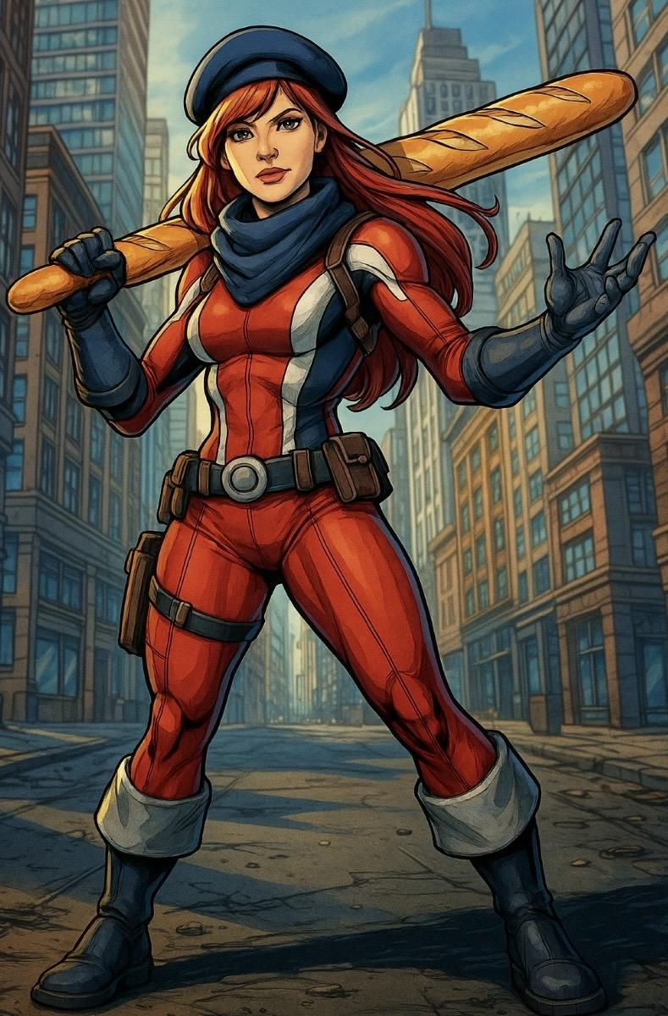
Jeanne Gris
Main Attack:
Ability 1:
Ability 2:
Super:

Slide 47
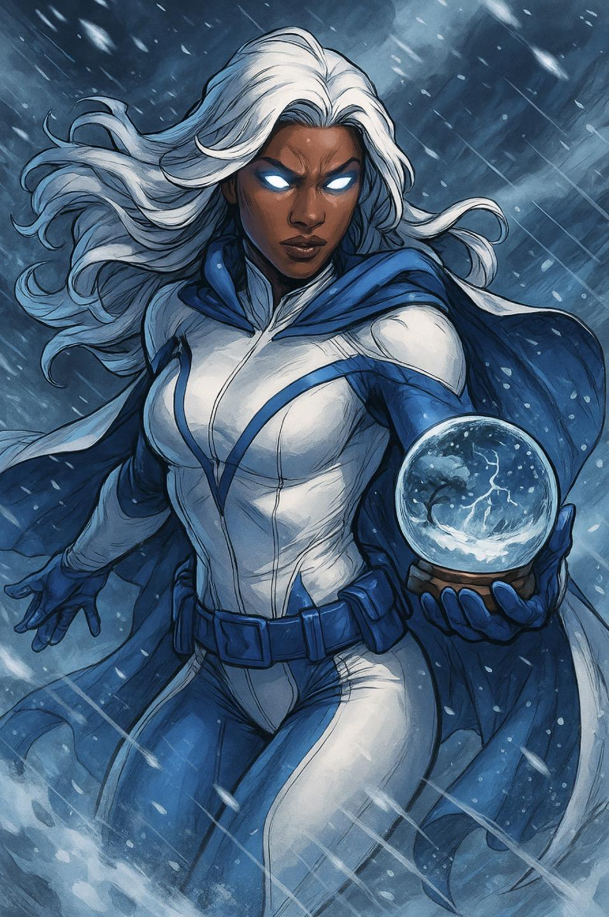
Winter WonderGirl
Main Attack: Super Snowglober
Winter Wondergirl throws a snow globe, which breaks and pulls enemies in
Ability 1: Shake it up
Winter Wondergirl makes it snow around her, freezing enemies
Ability 2: Rain down the sun fog
Winter Wondergirl breaks a snowglobe with a lot of fog, causing a smoke bomb
Super: Wonderlate the multisphere
Winter Wondergirl builds a giant snow globe, any enemies in it take a ton of damage and are slowed

Slide 48
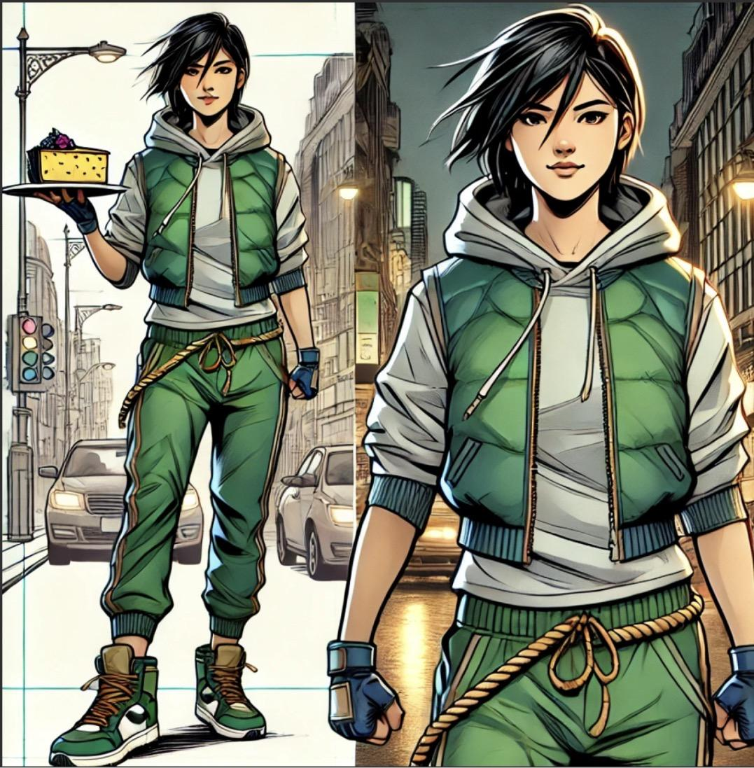
Smurtle Gurltle Cheesecake Woman
Main Attack: Krazy Karate Kicks
SGCW kicks with a three kick combo
Ability 1: Super Ultra Tornado Spin
Ninja Mode - SGCW does a stunning spin kick
Turtle Mode - SGCW spins around in her turtle shell and is invincible throughout
Ability 2: Mega Tsunami Cheesecake
Ninja Mode - SGCW dashes forward spilling slowing cheesecake behind her
Turtle Mode - SGCW consumes her cheesecake to gain health and movement speed
Super: Supersaiyan Ultra Cheesecake Weapon Ninja Gurl Explosion!
SGCW switches to the other mode. Ninja Mode has low health and high speed. Turtle mode has low speed high health. SGCW gets a attack boost after switching

Slide 49
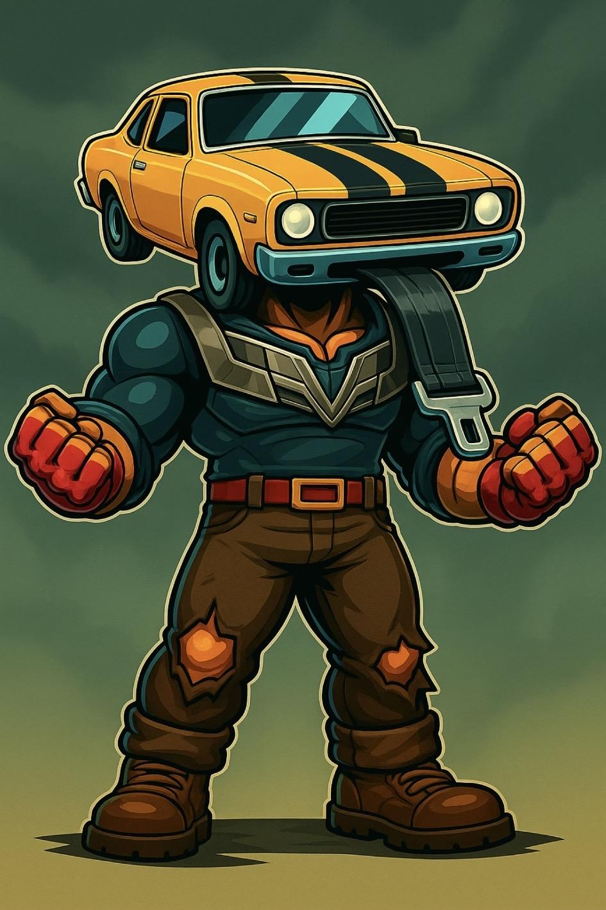
Belt Tungus
Main Attack:
Ability 1:
Ability 2:
Super:

Slide 50
Hawktalkers

Slide 51

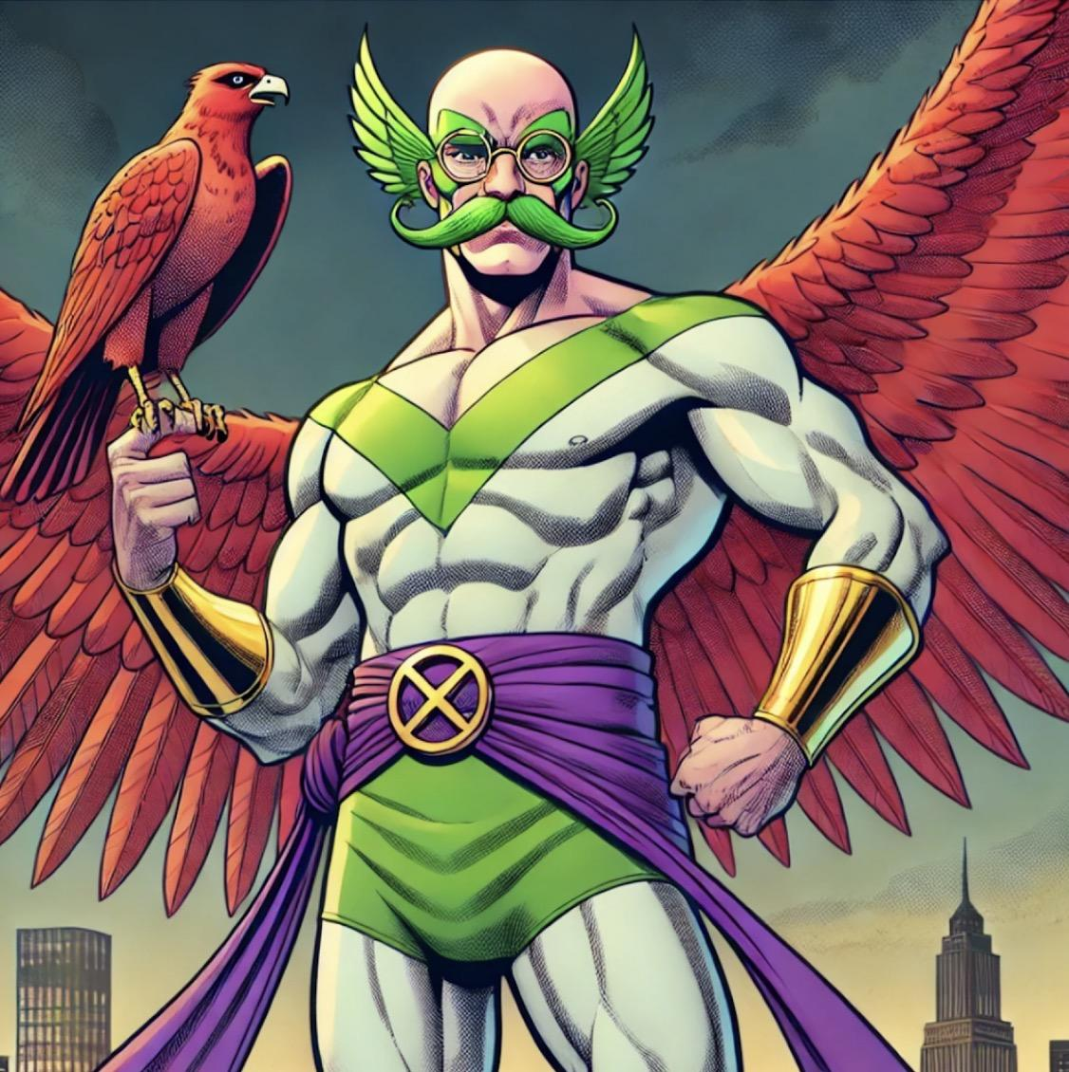
Moonhawk

Slide 52
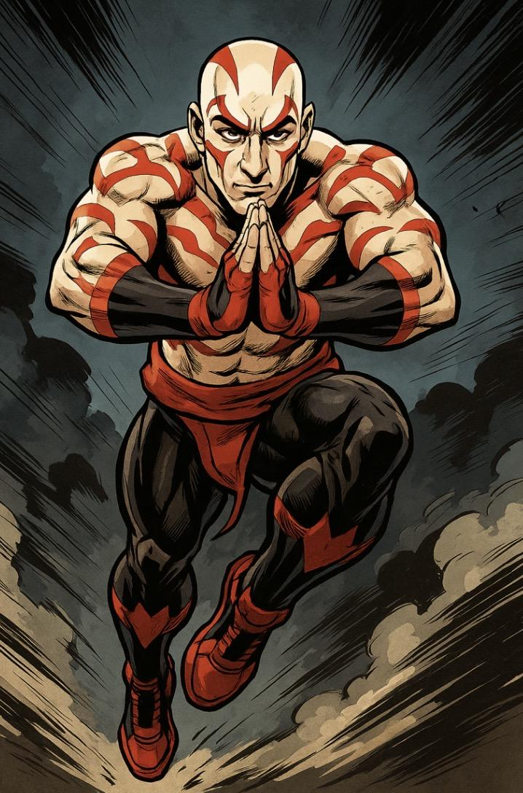
They

